Slide 1
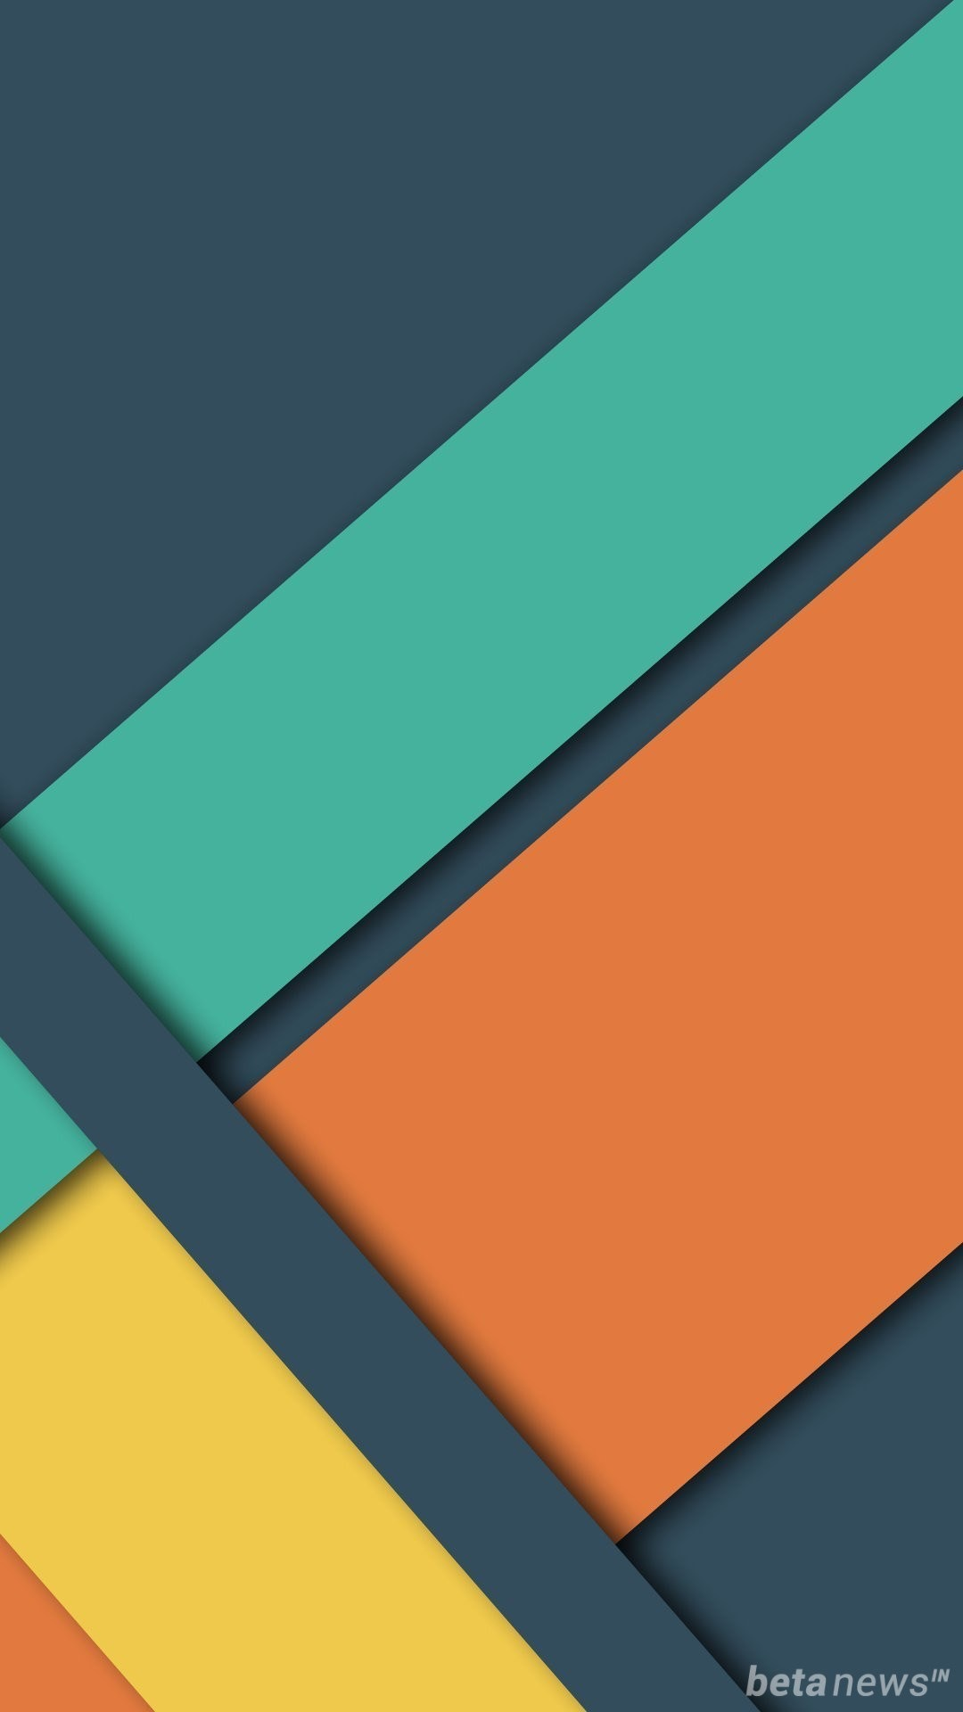
Material Design

Slide 2
What is Material Design?
Design language developed by Google
Announced in 2014 at the Google I/O conference
Part of Google’s design evolution
Established to unite Google’s diverse product line
Common attributes: Bright colors, large images, depth
What are the principles?

Slide 3
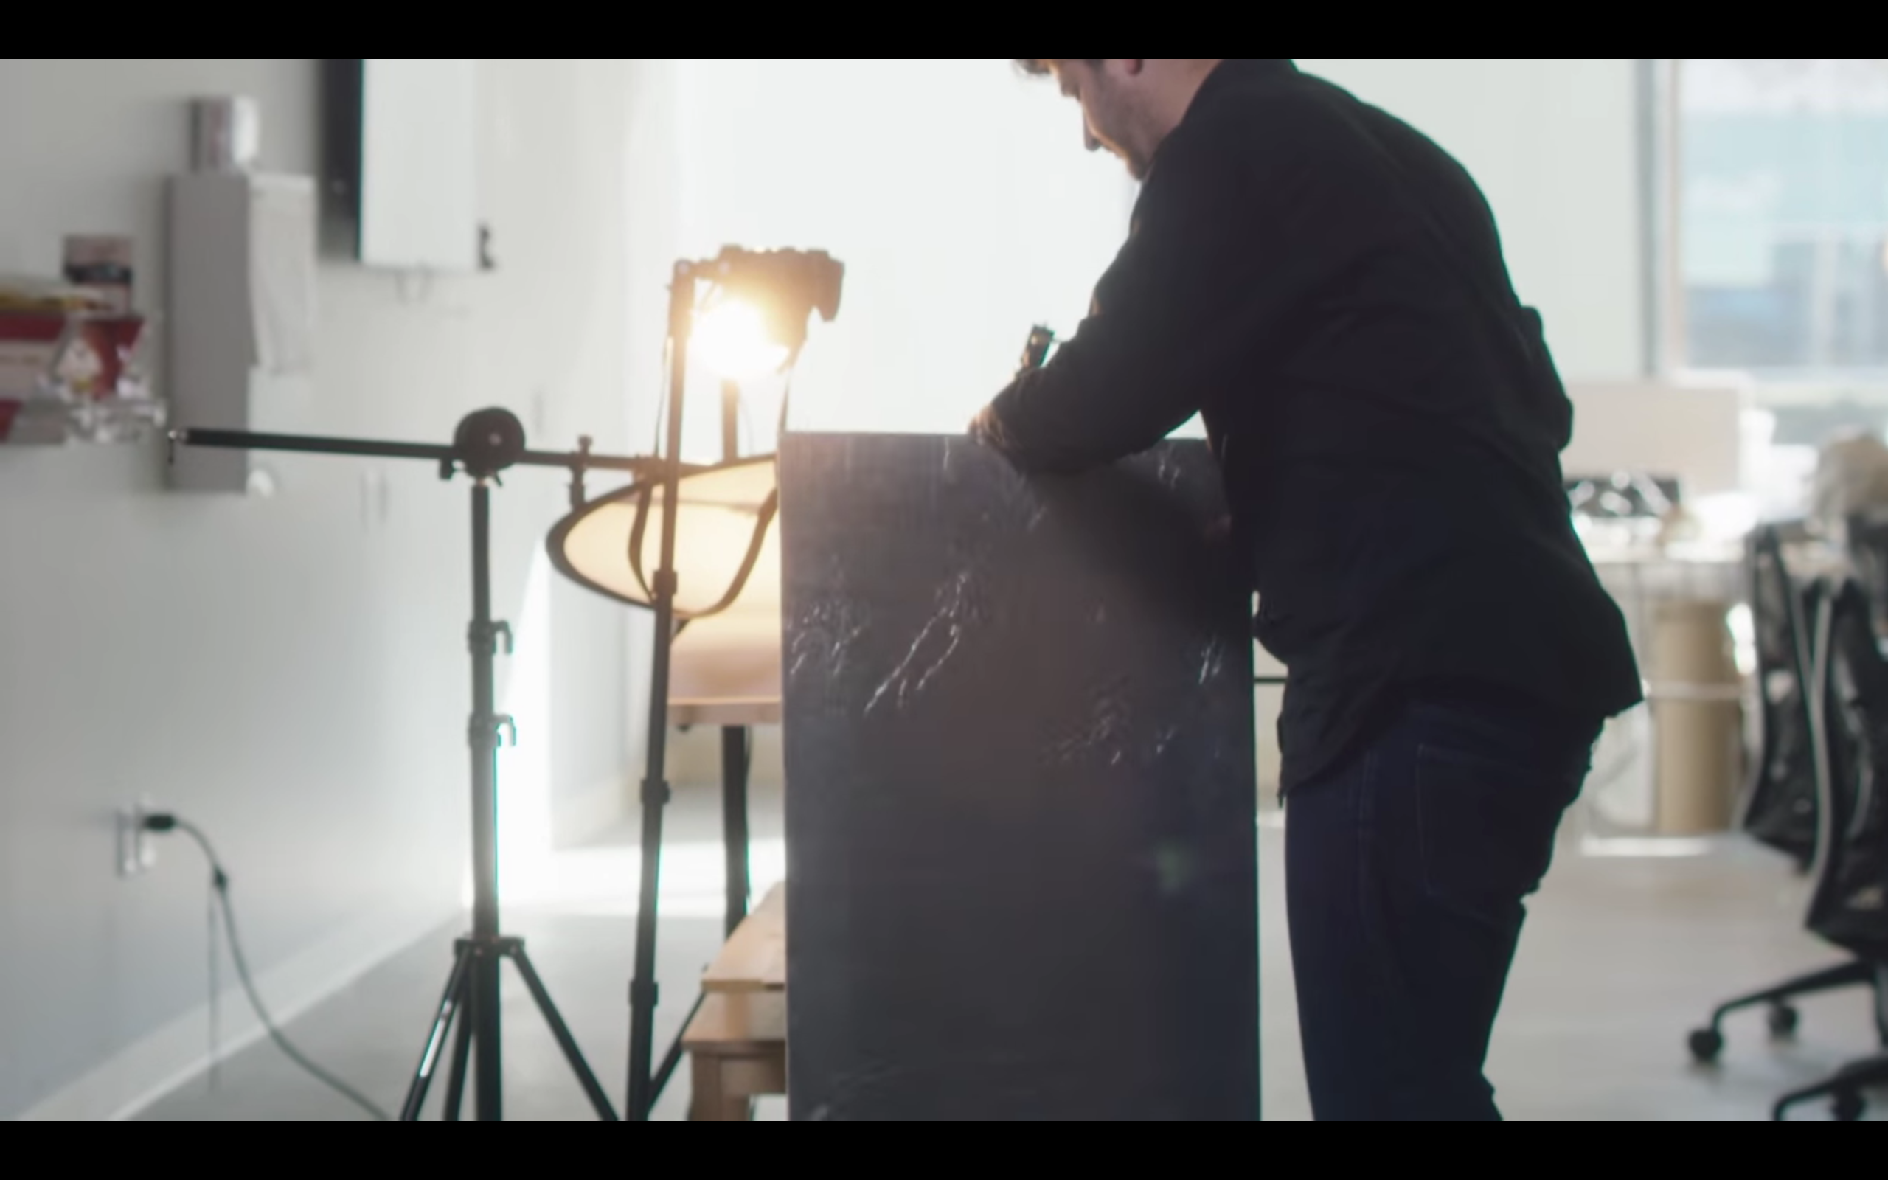
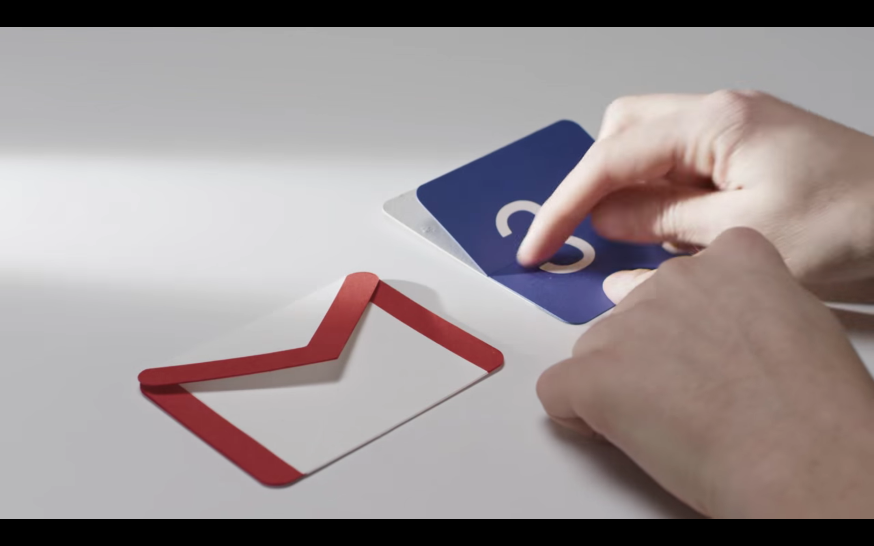
Principles
Material is the metaphor

Slide 4

Principles
Material is the metaphor

Slide 5
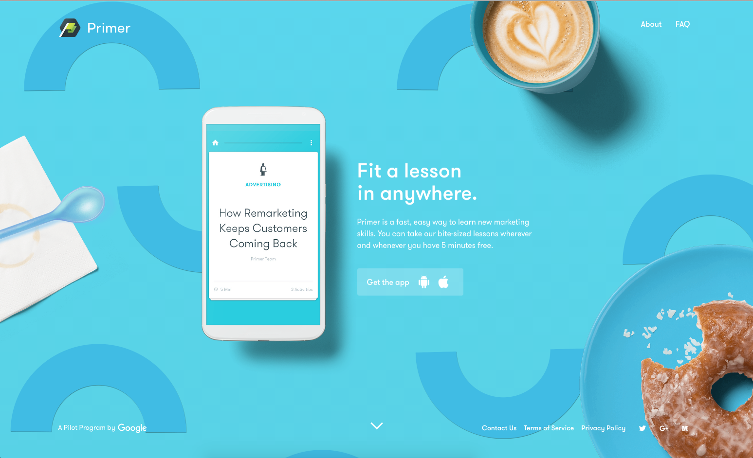
Principles
Bold, graphic, intentional

Slide 6
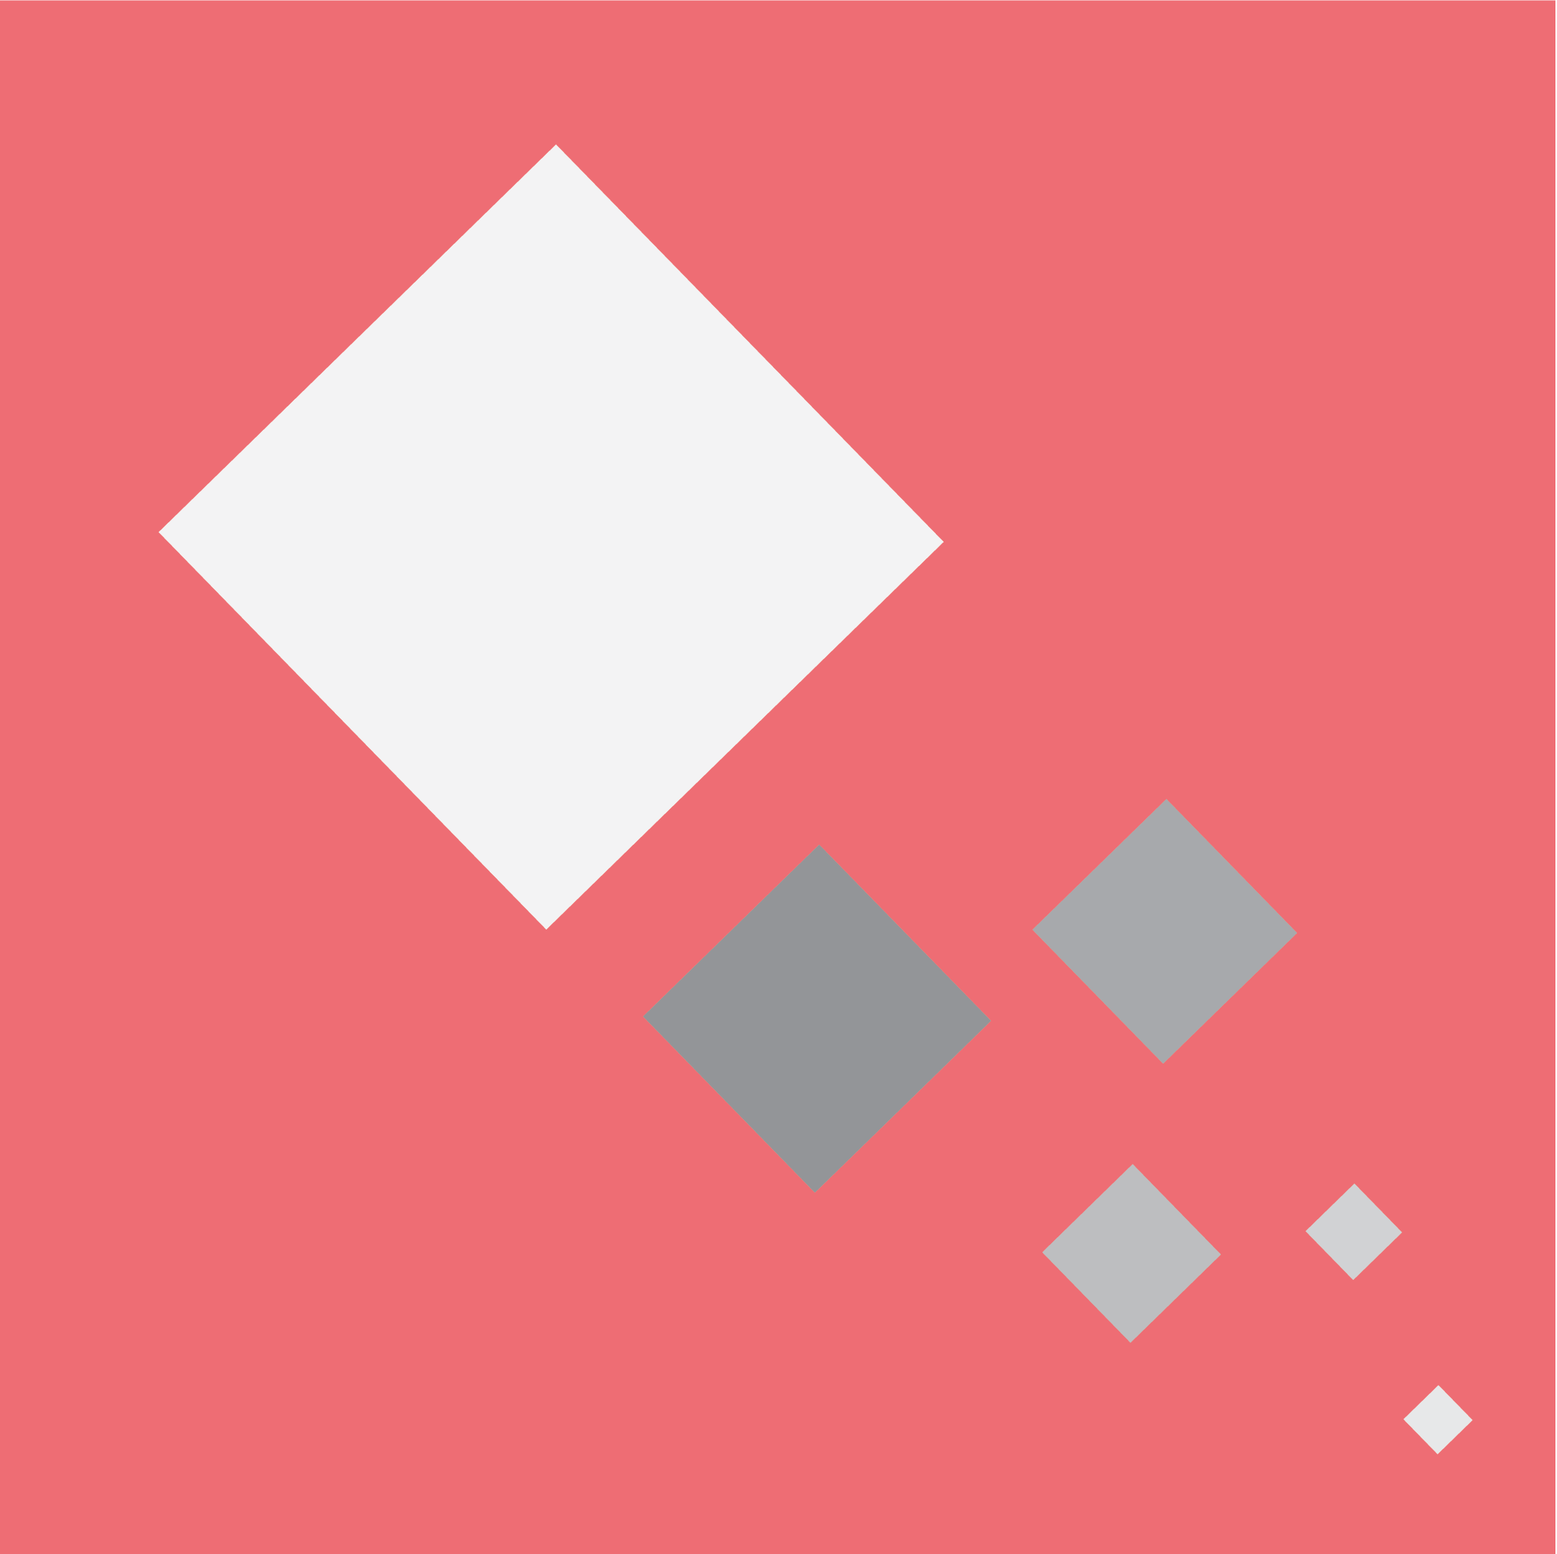
Principles
Motion provides meaning

Slide 7
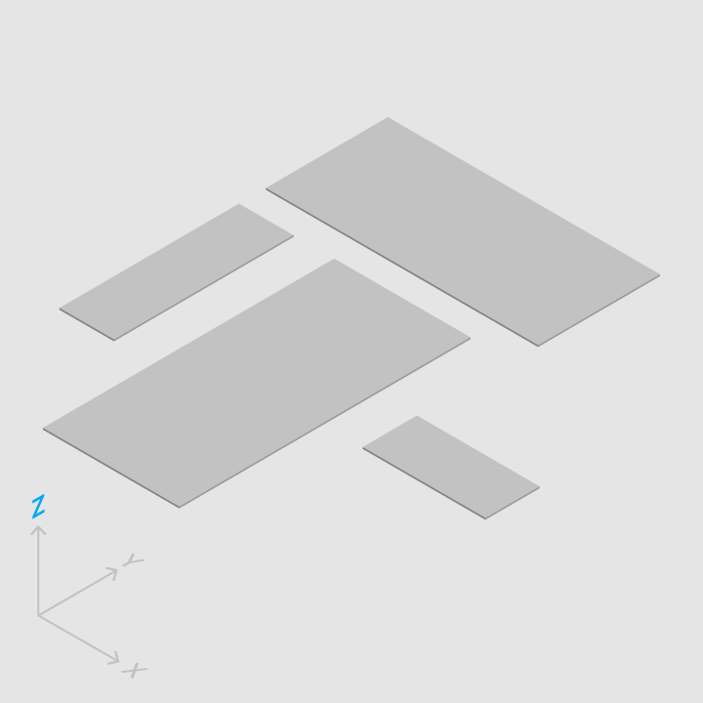
The Material Environment
The Material environment is a 3D space
All objects have an x, y and z dimension
Material Design philosophy strives for “clean” design and simplicity
Different from traditional flat design

Slide 8
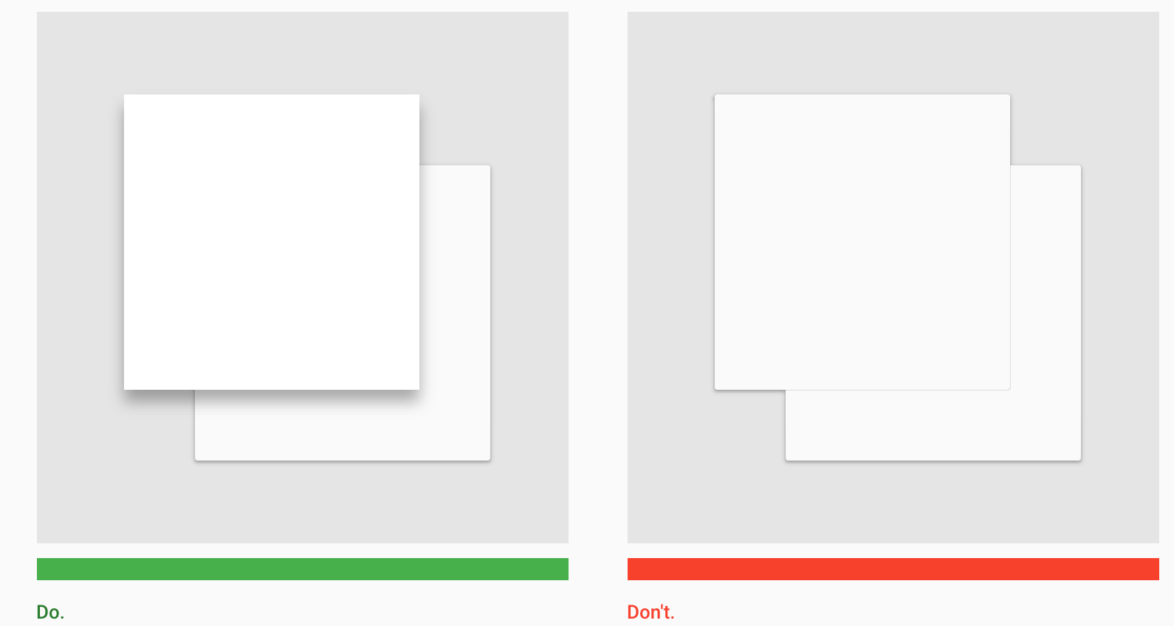
The Material Environment

Slide 9
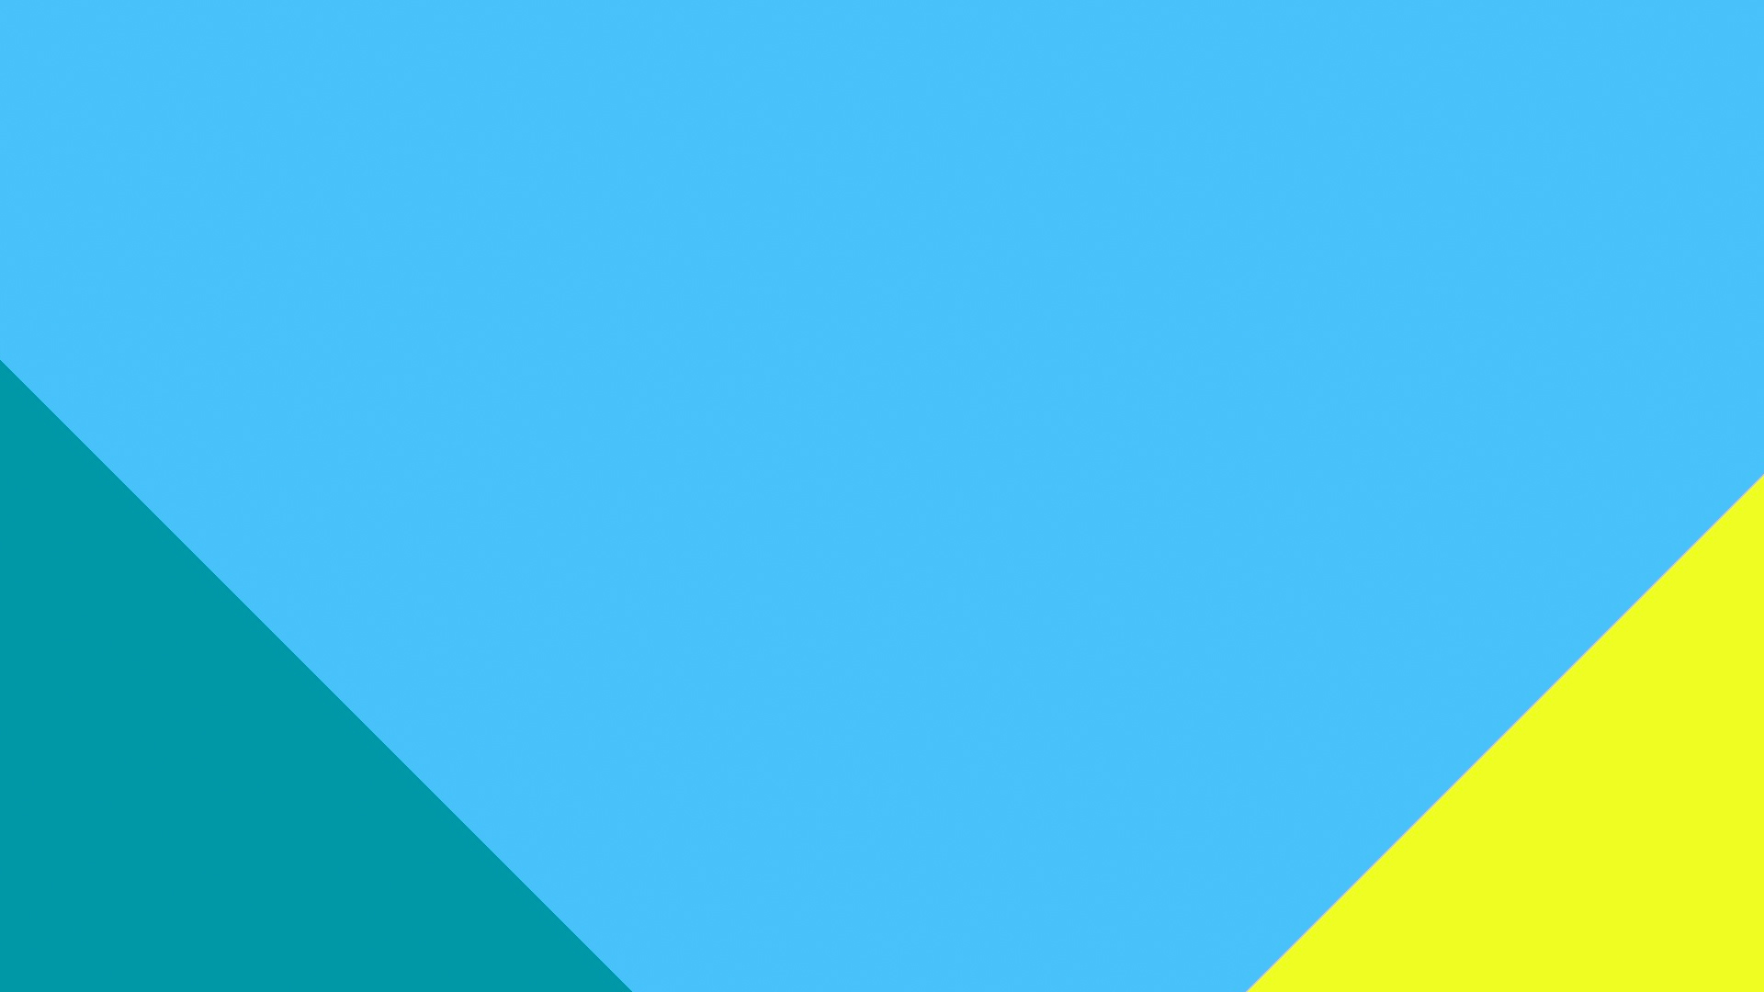
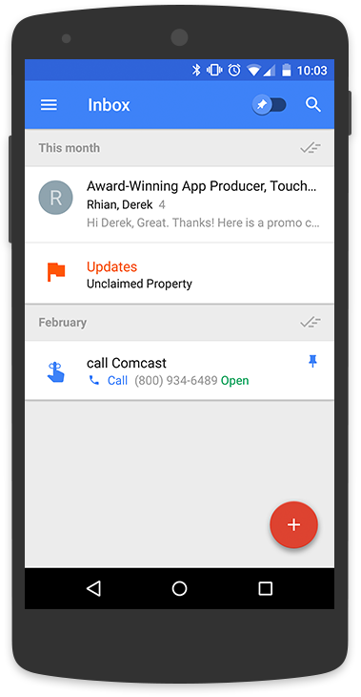

Slide 10
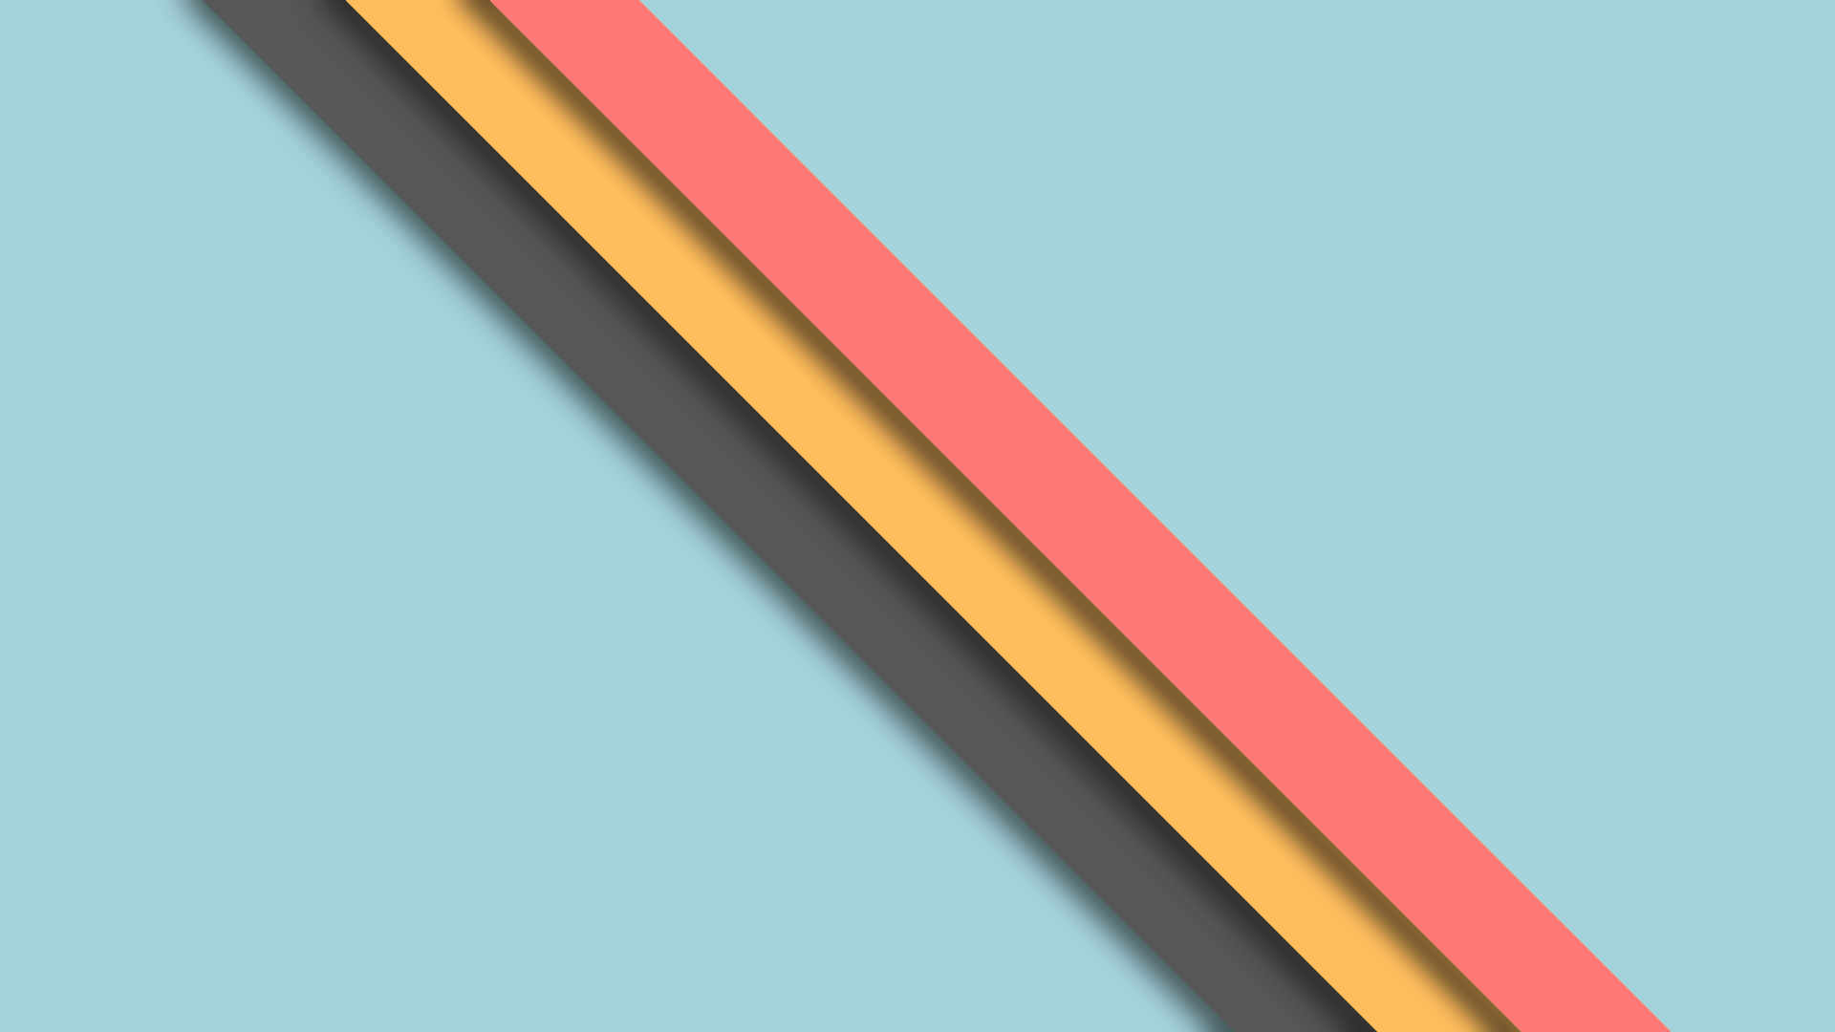
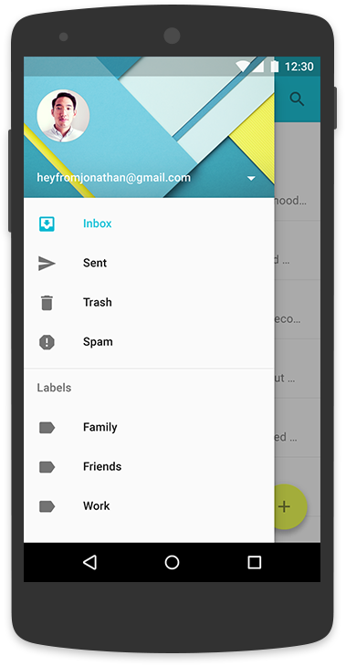

Slide 11
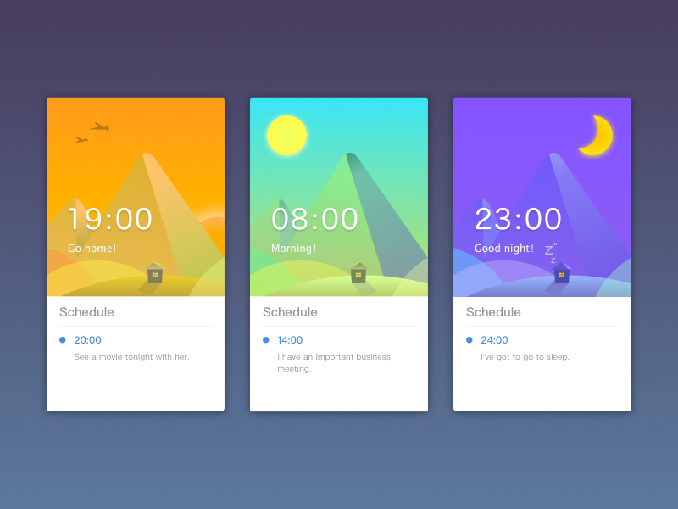
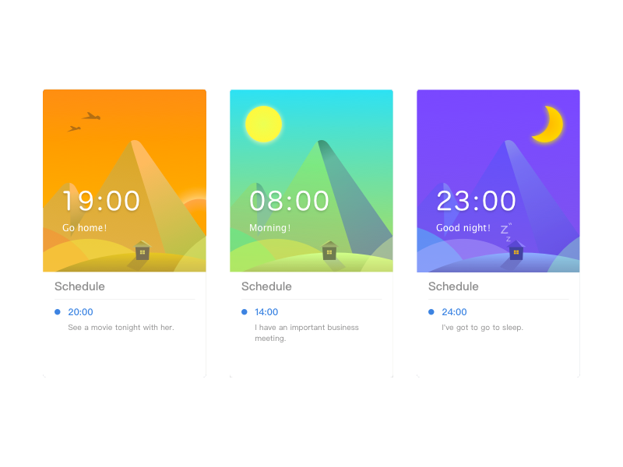

Slide 12
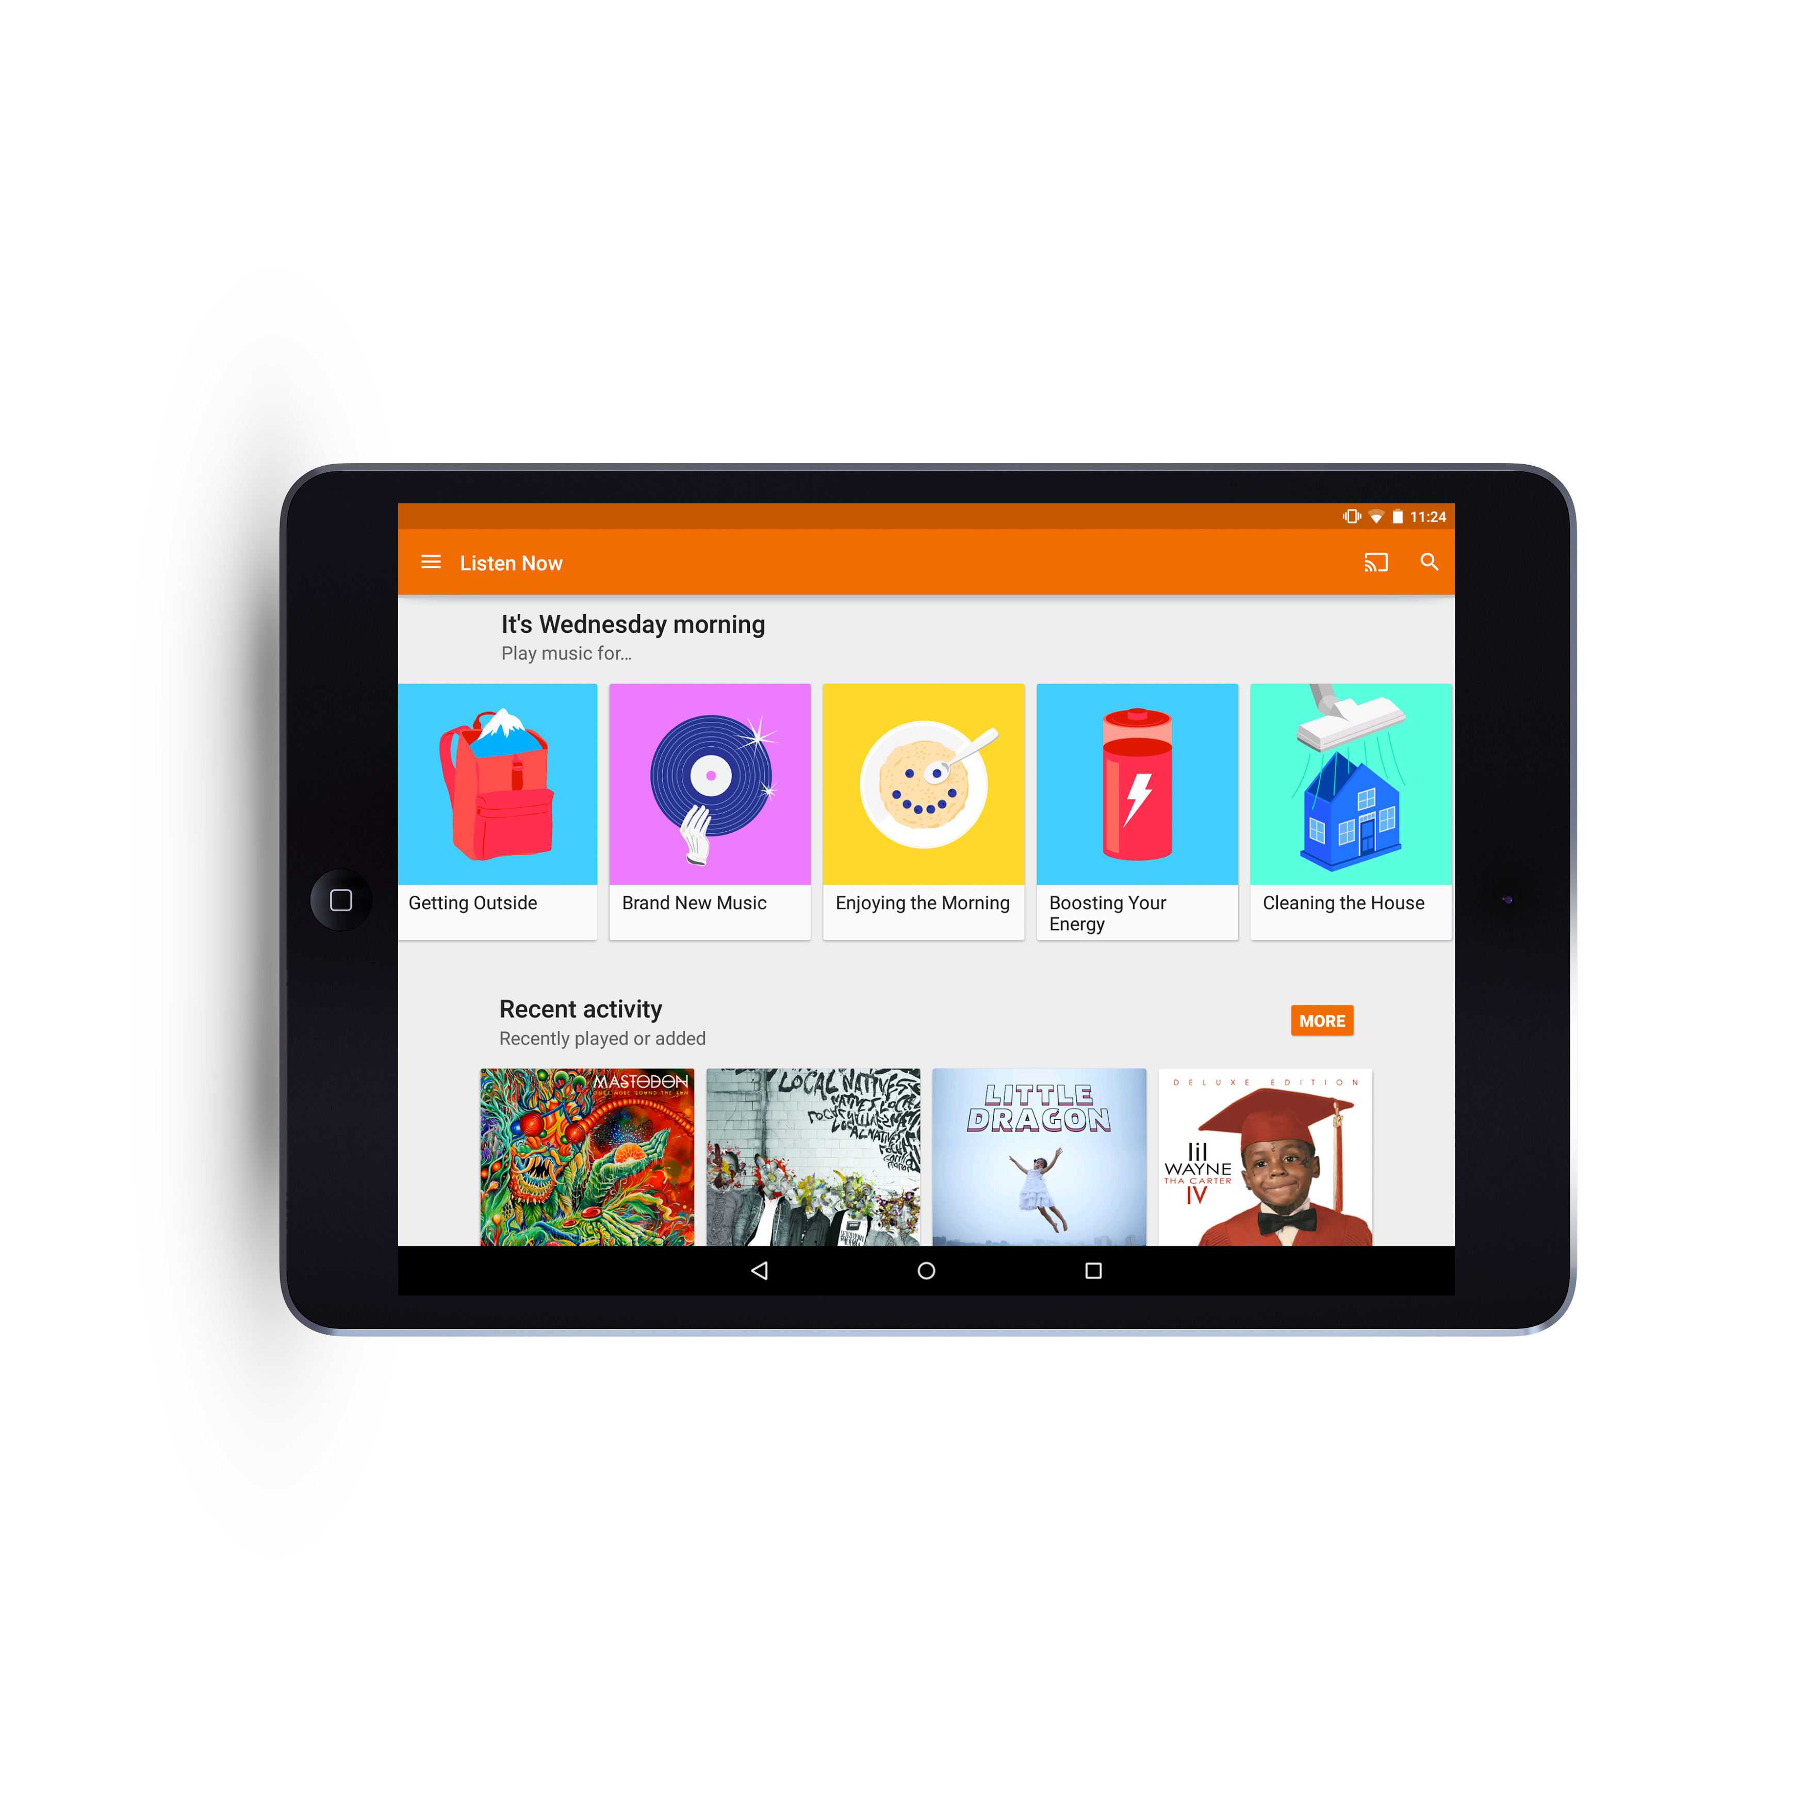

Slide 13
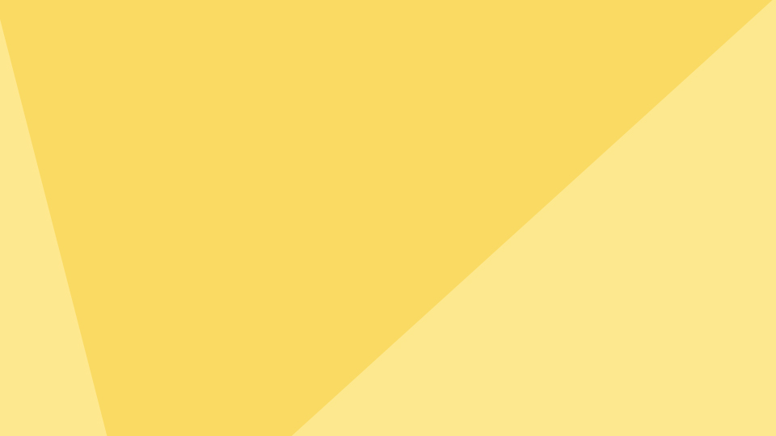
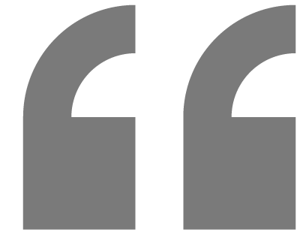
Color in material design is inspired by bold hues juxtaposed with muted environments, deep shadows, and bright highlights.

Slide 14
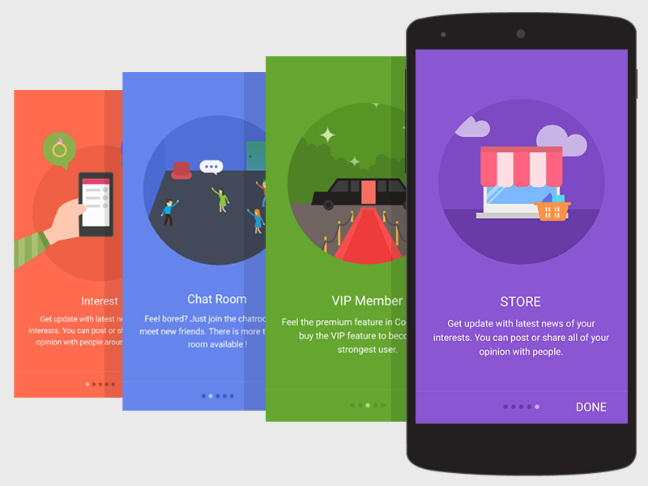

Slide 15
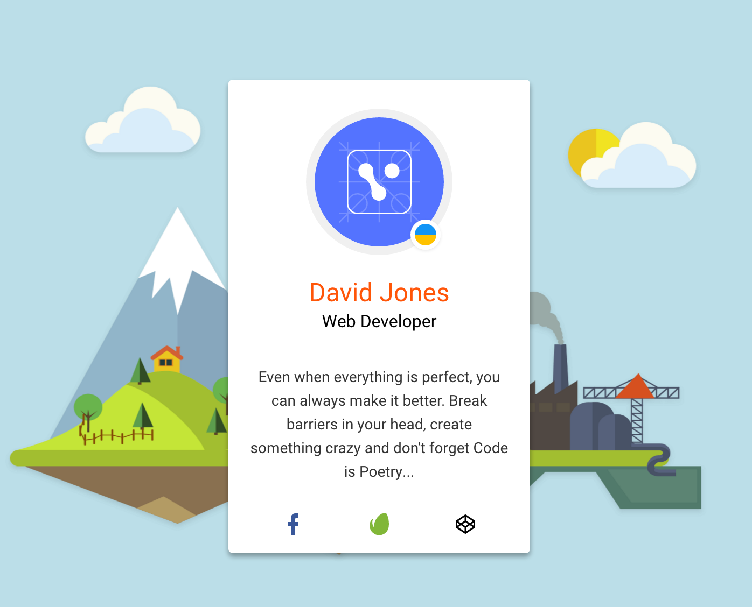

Slide 16
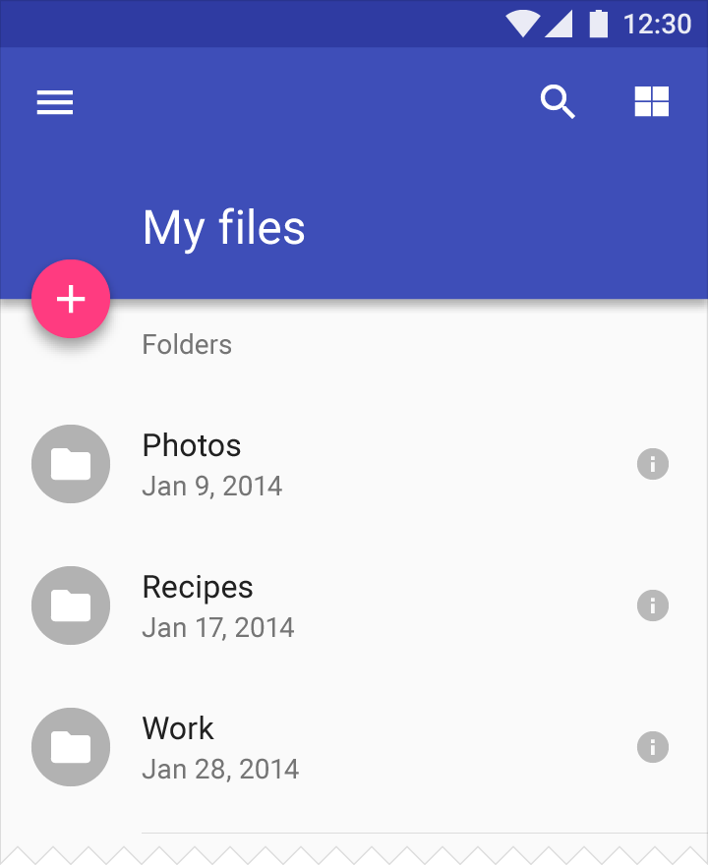
Color
Color palette consists of primary and accent colors
Primary color should be the most widely used
All color palettes should include sufficient contrast between different UI elements
Google’s specs are highly definitive
Palettes can be custom or online generated. Examples: Material palette, Material UI, Material Mixer

Slide 17

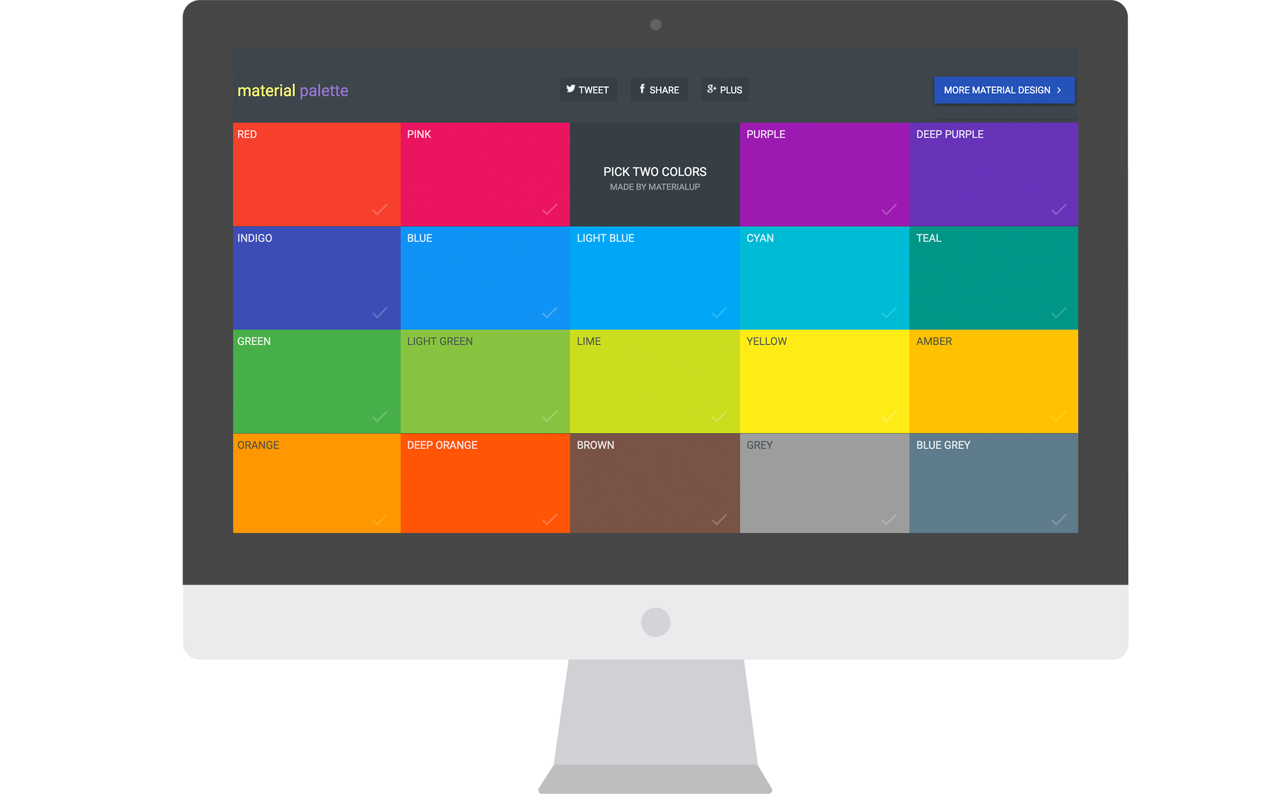
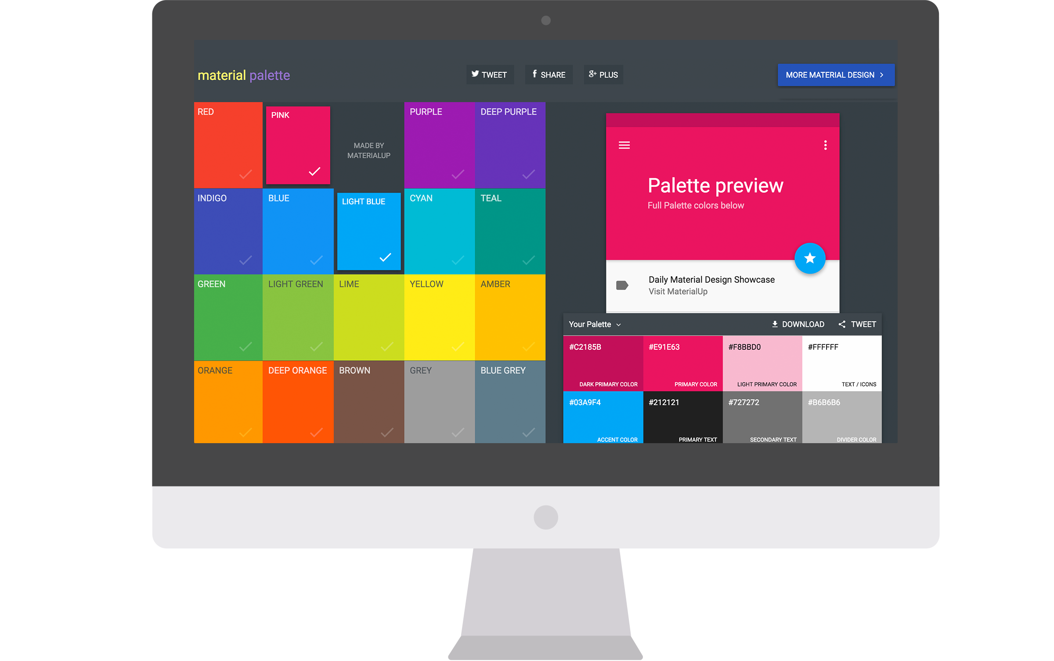
Material Palette

Slide 18
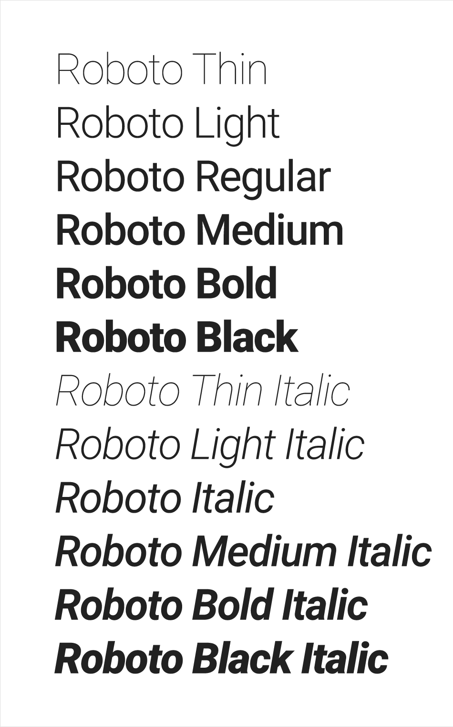
Typography
Guidelines recommend using Roboto. It has six weights: Thin, Light, Regular, Medium, Bold, and Black
Font was designed entirely in-house
Google describes the font as "modern, yet approachable" and "emotional”
Roboto was redesigned in 2014 to scale across a universe of products

Slide 19
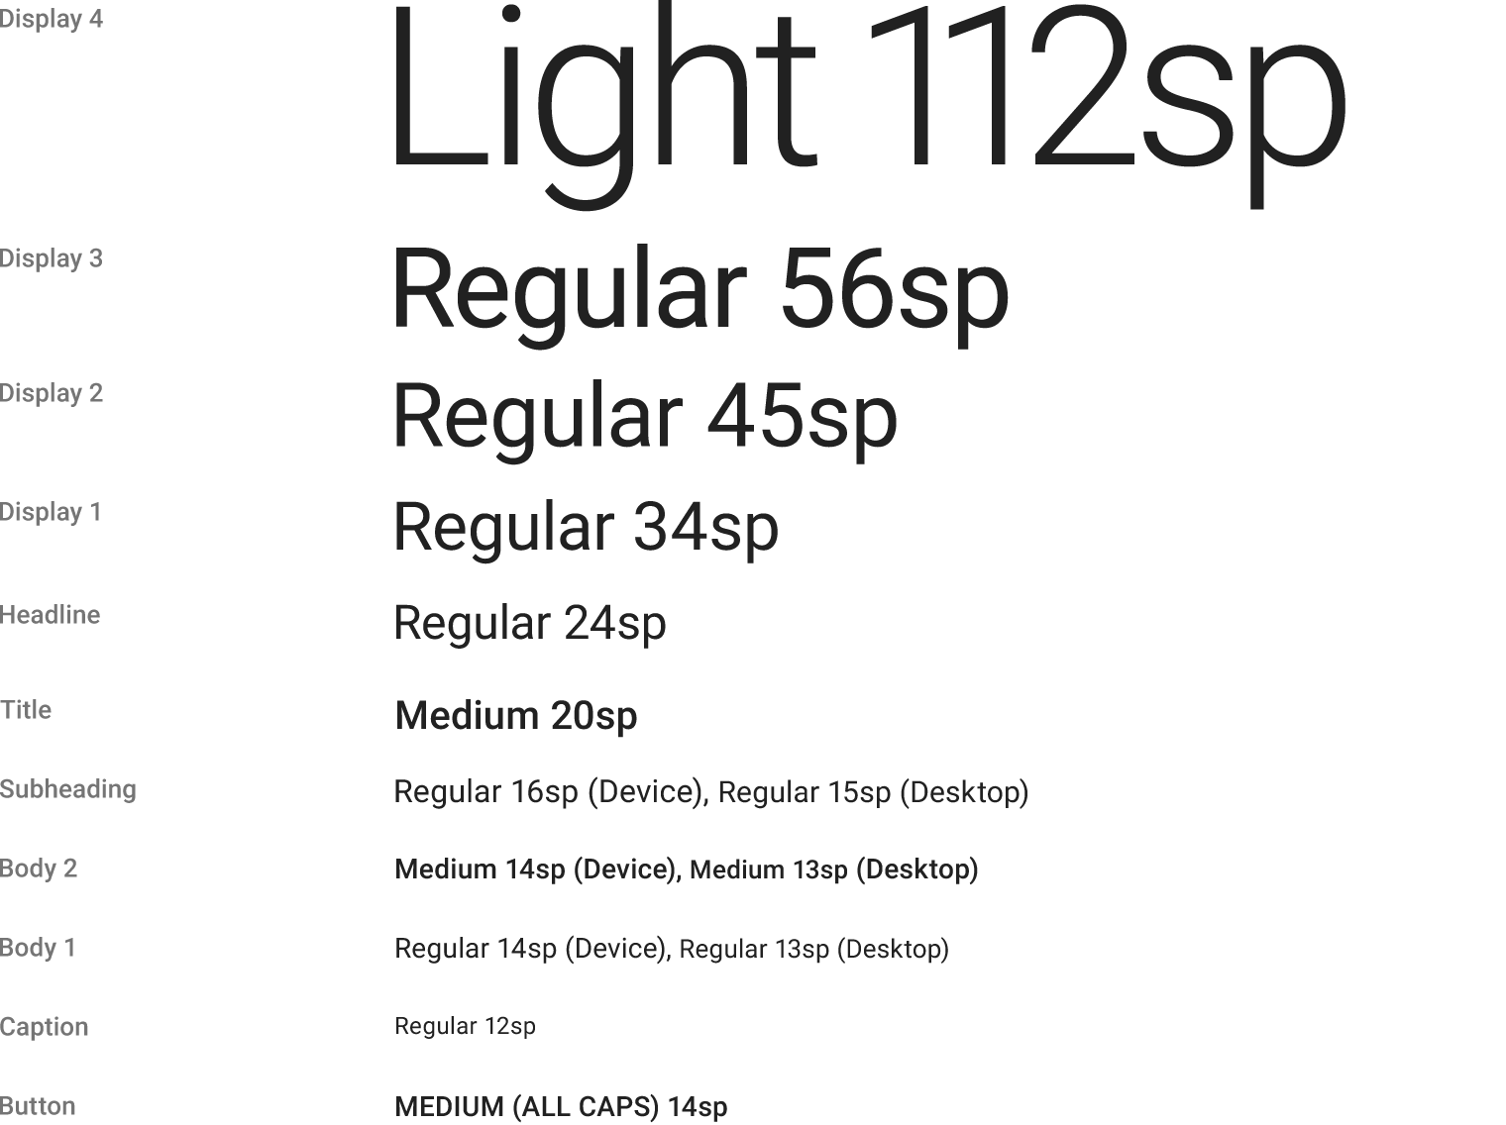
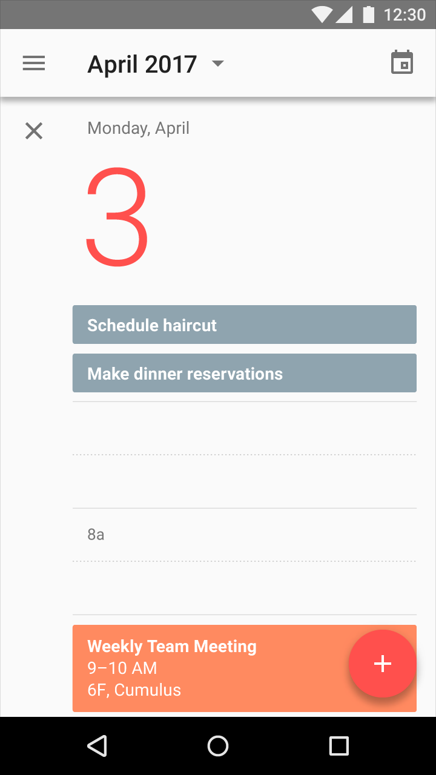
Typography

Slide 20
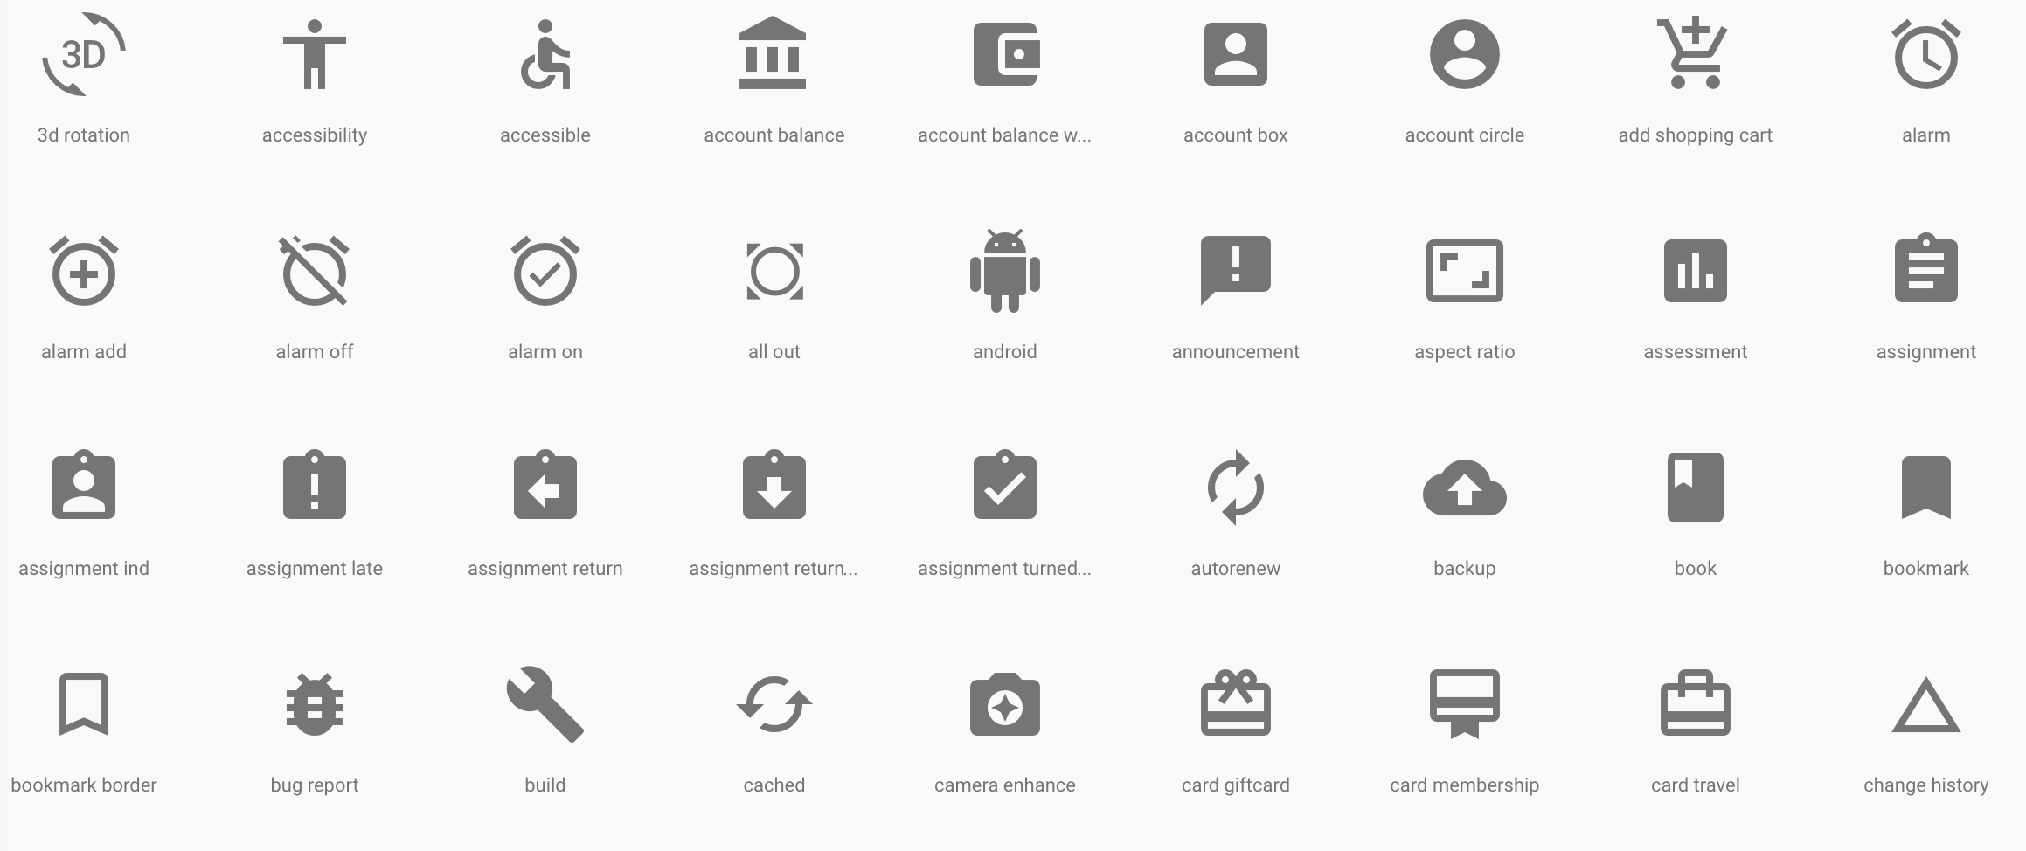
Icons

Slide 21
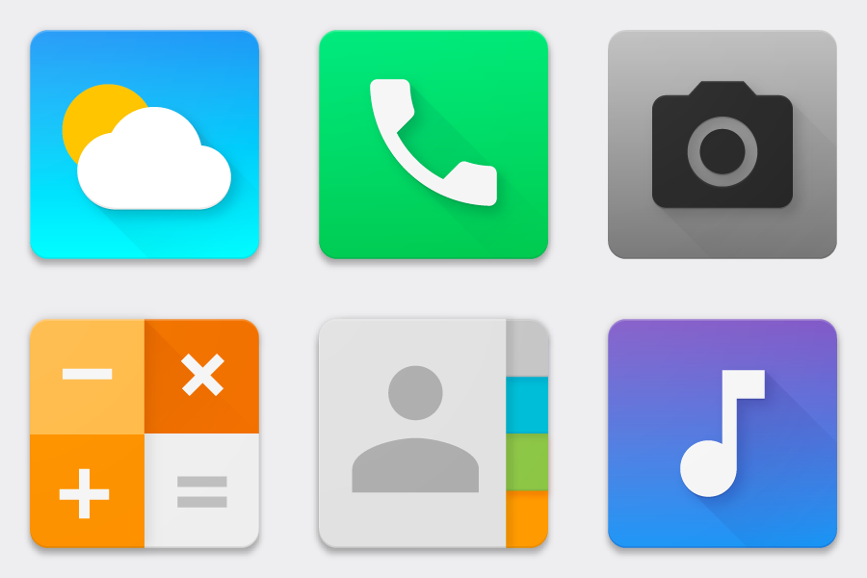

Slide 22
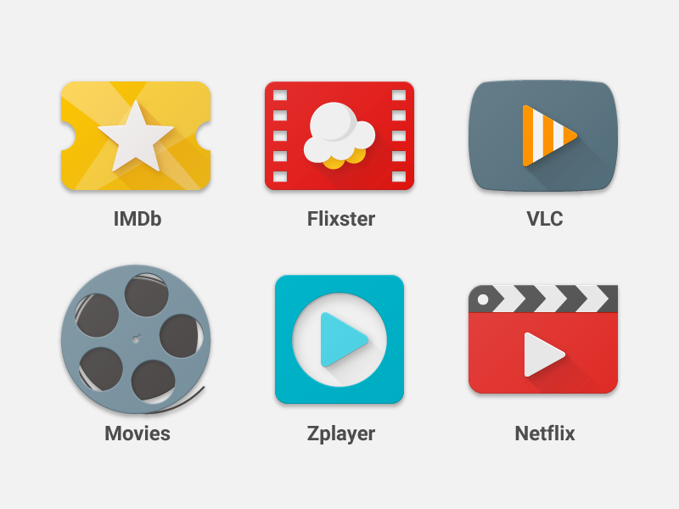

Slide 23
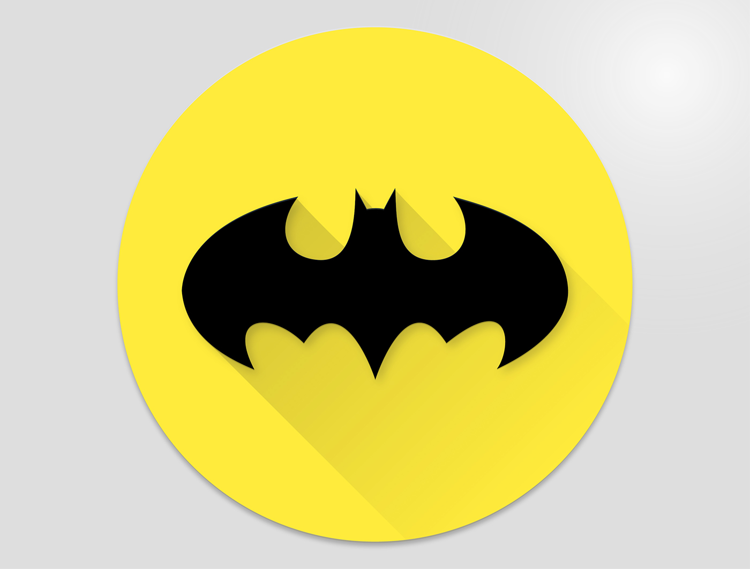
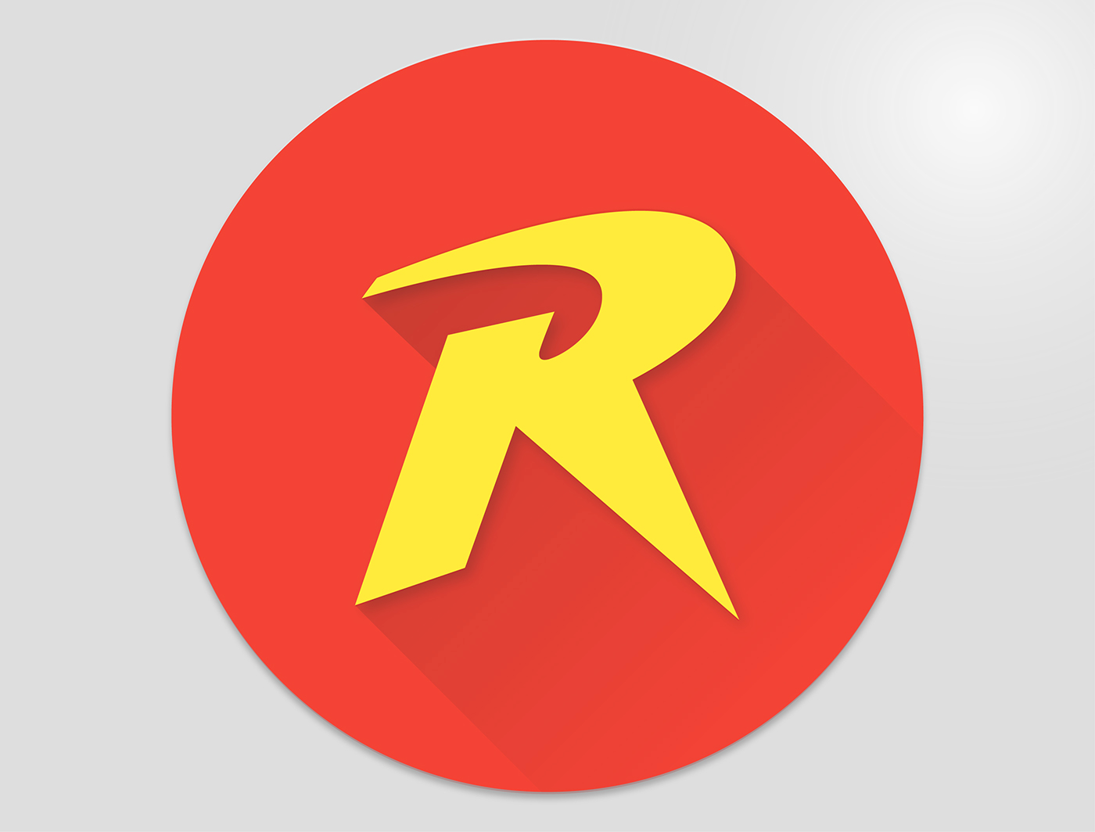
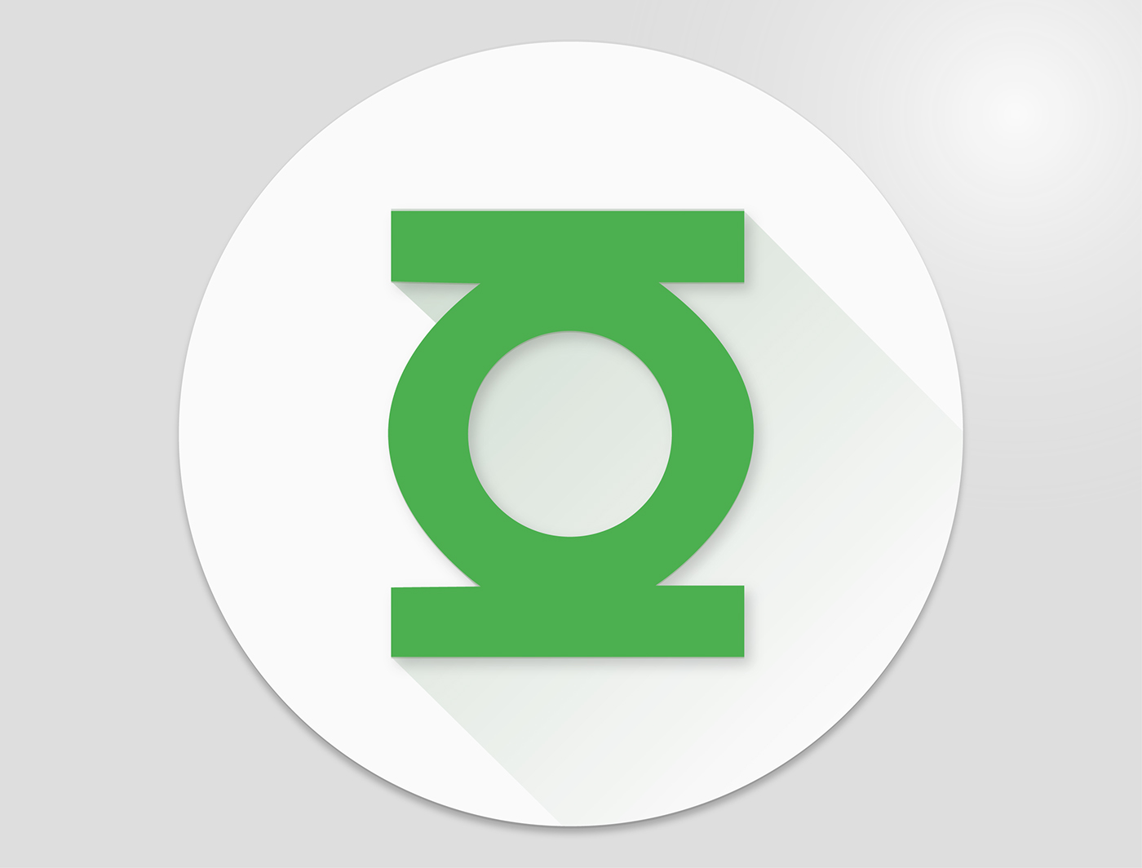
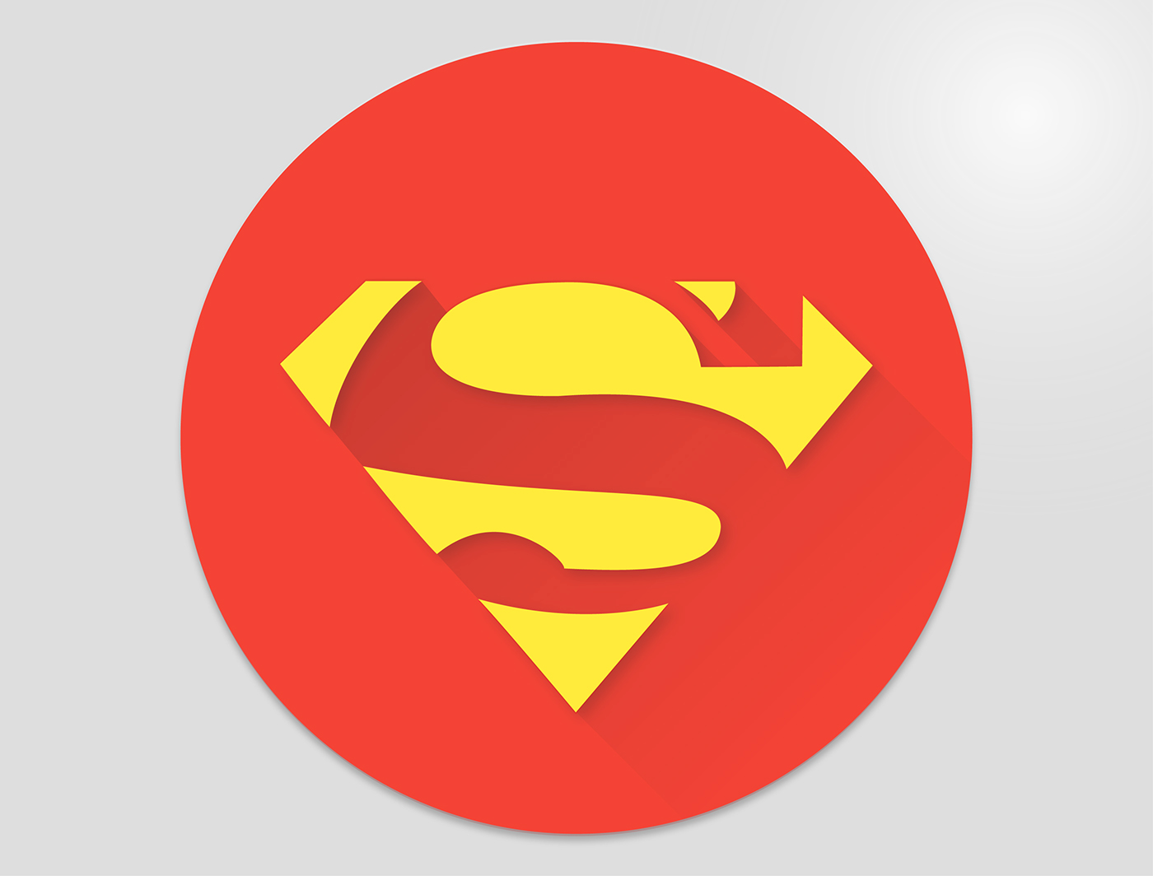
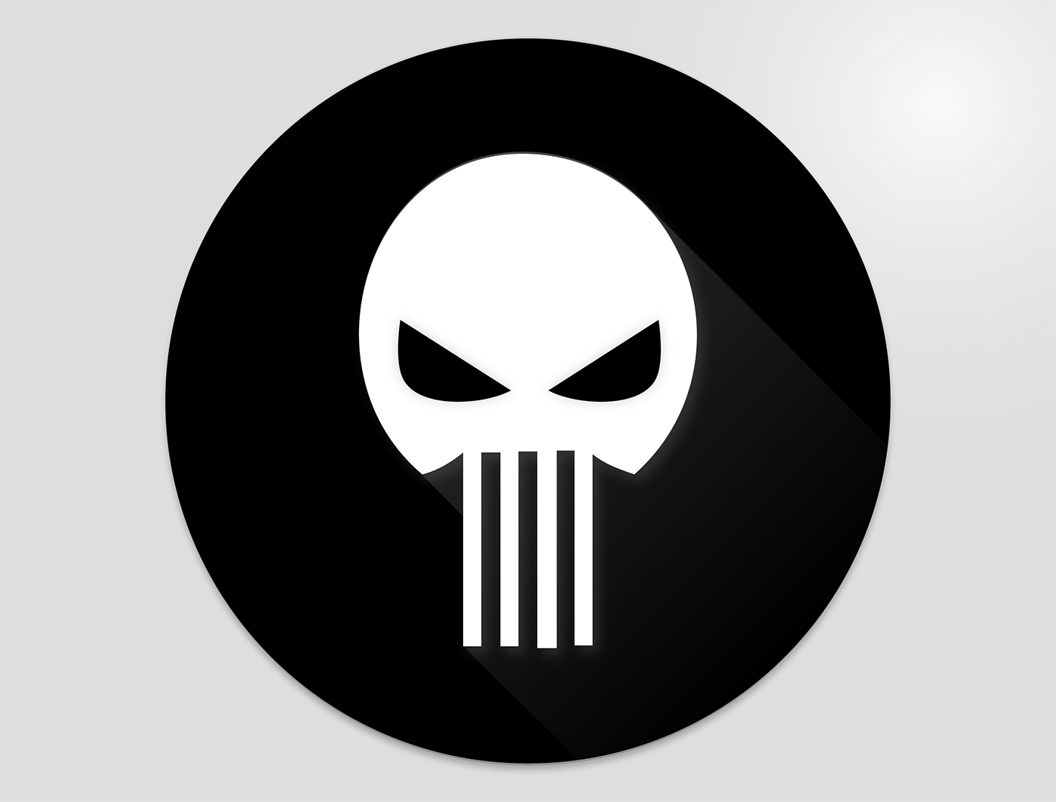
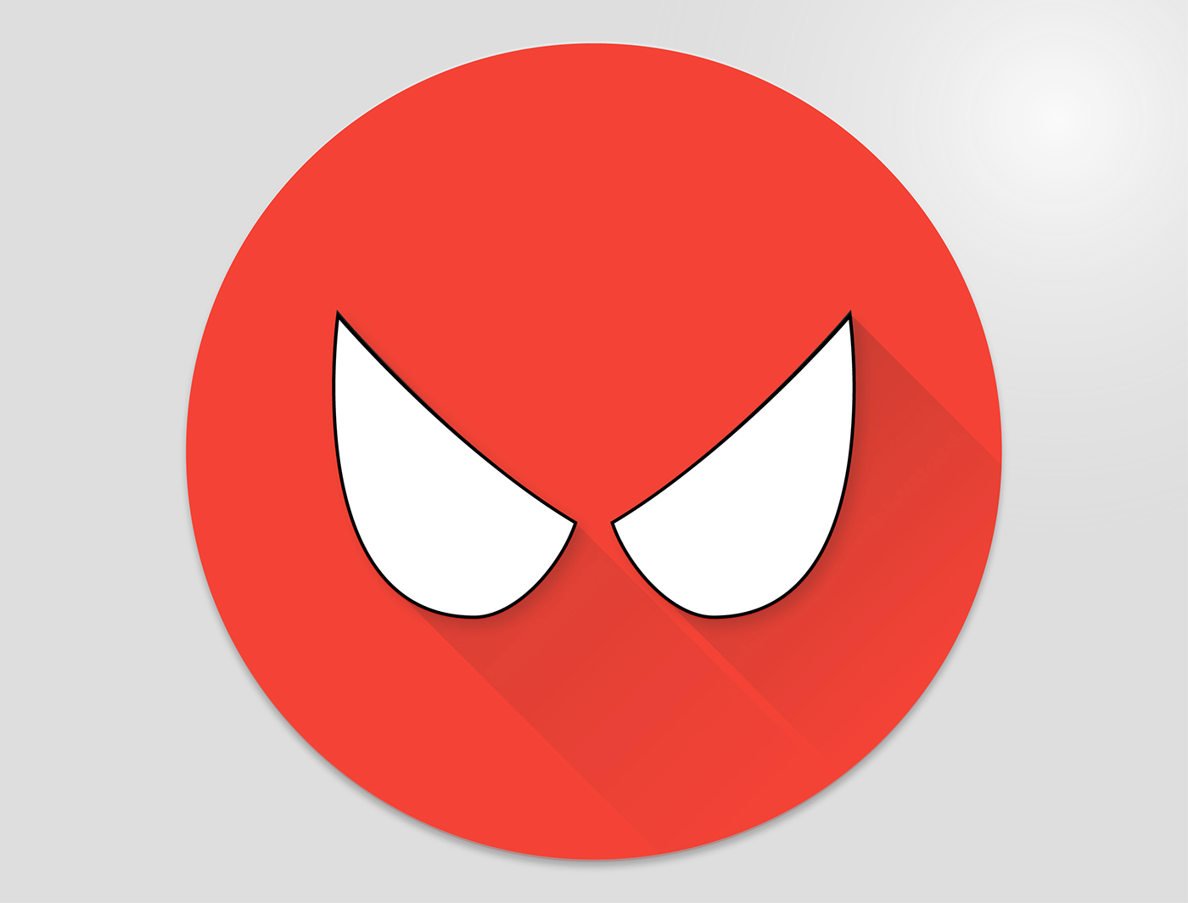
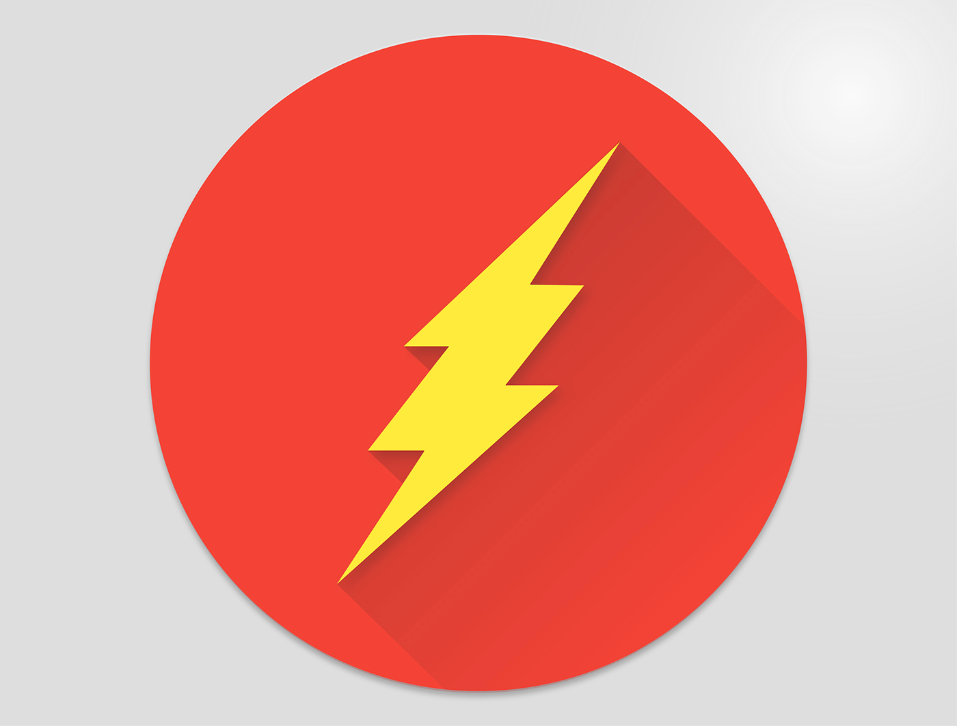
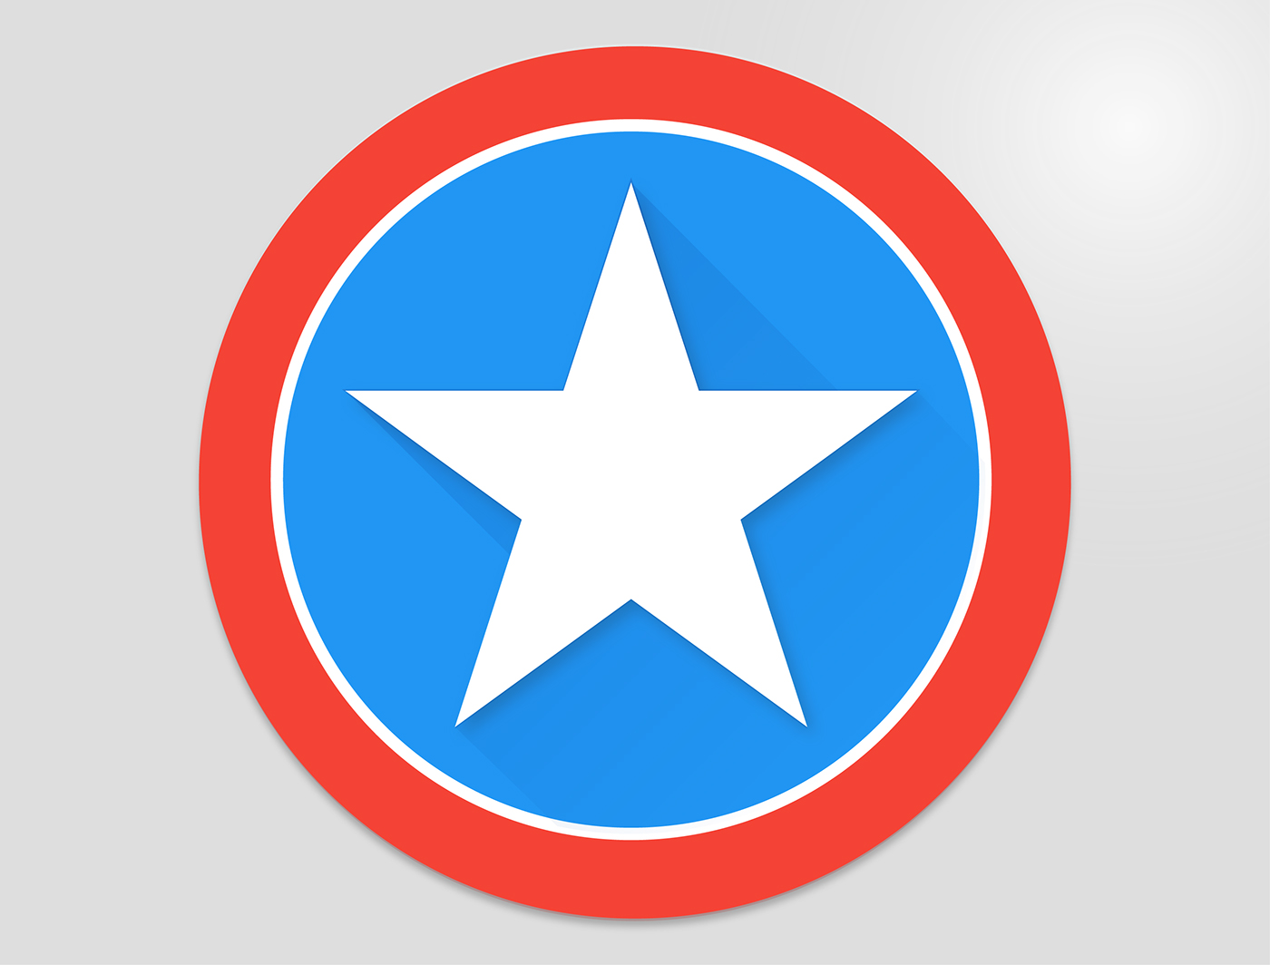
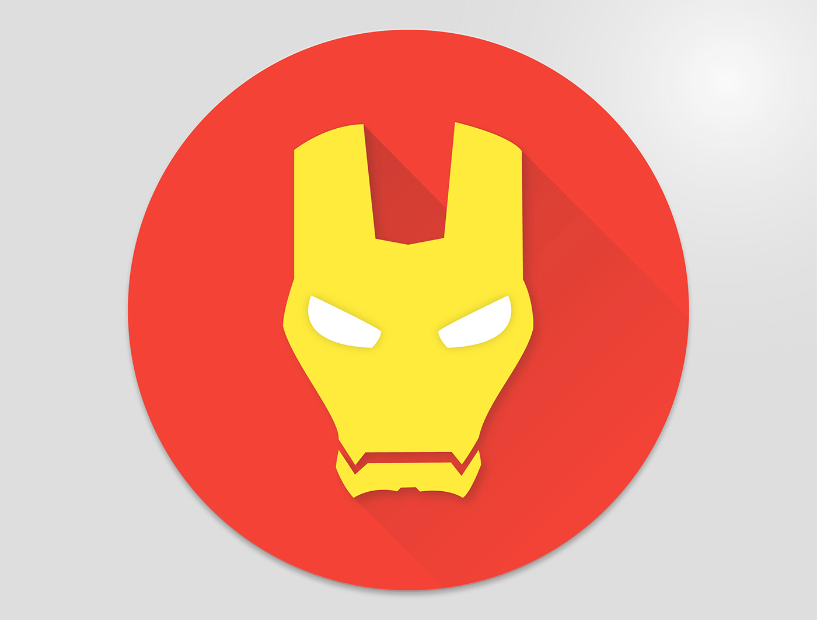

Slide 24
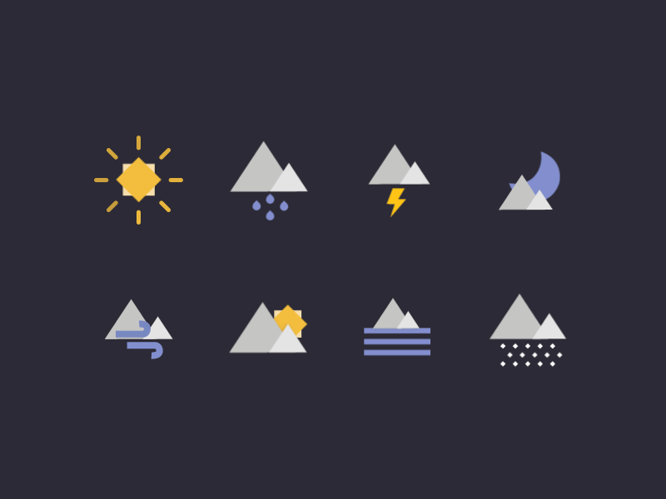

Slide 25
Imagery
Choose images that express personal relevance, information, and delight
Avoid stock photography
Have a point of focus
The image should tell a story
Both photography and illustrations can live within the same product

Slide 26
https://www.youtube.com/watch?v=NVb8bGcHH1w&feature=youtu.be

Slide 27
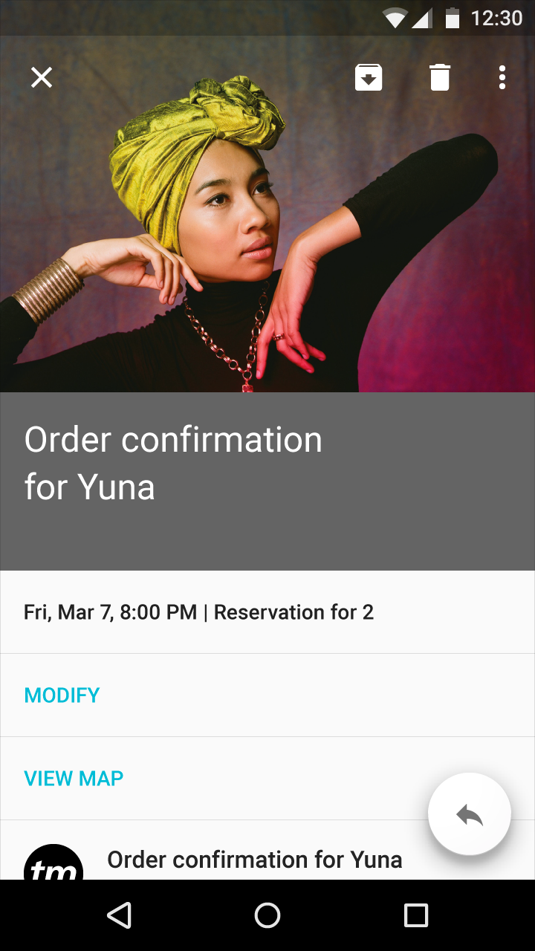
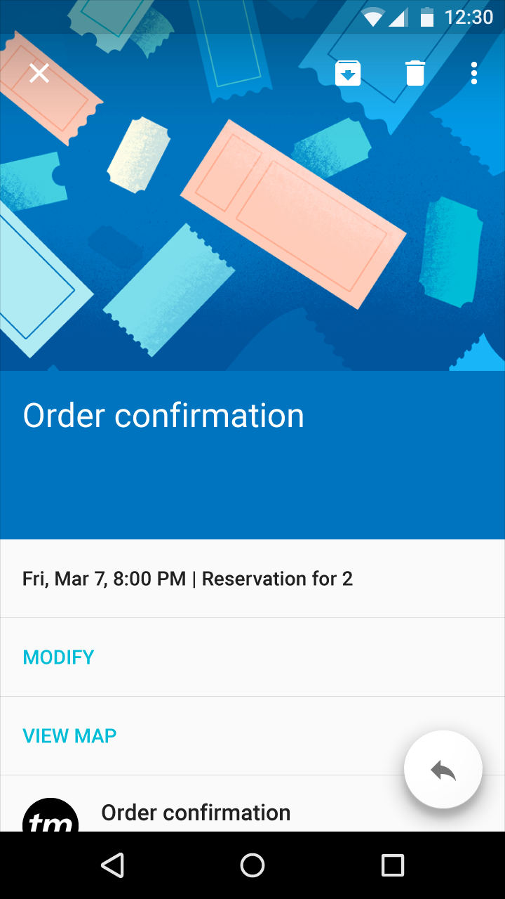

Slide 28
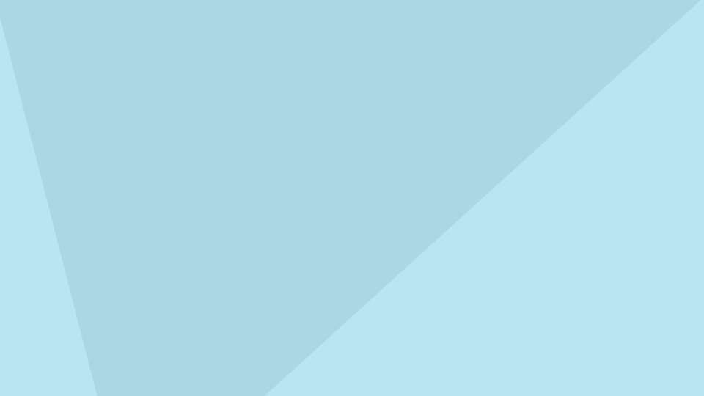
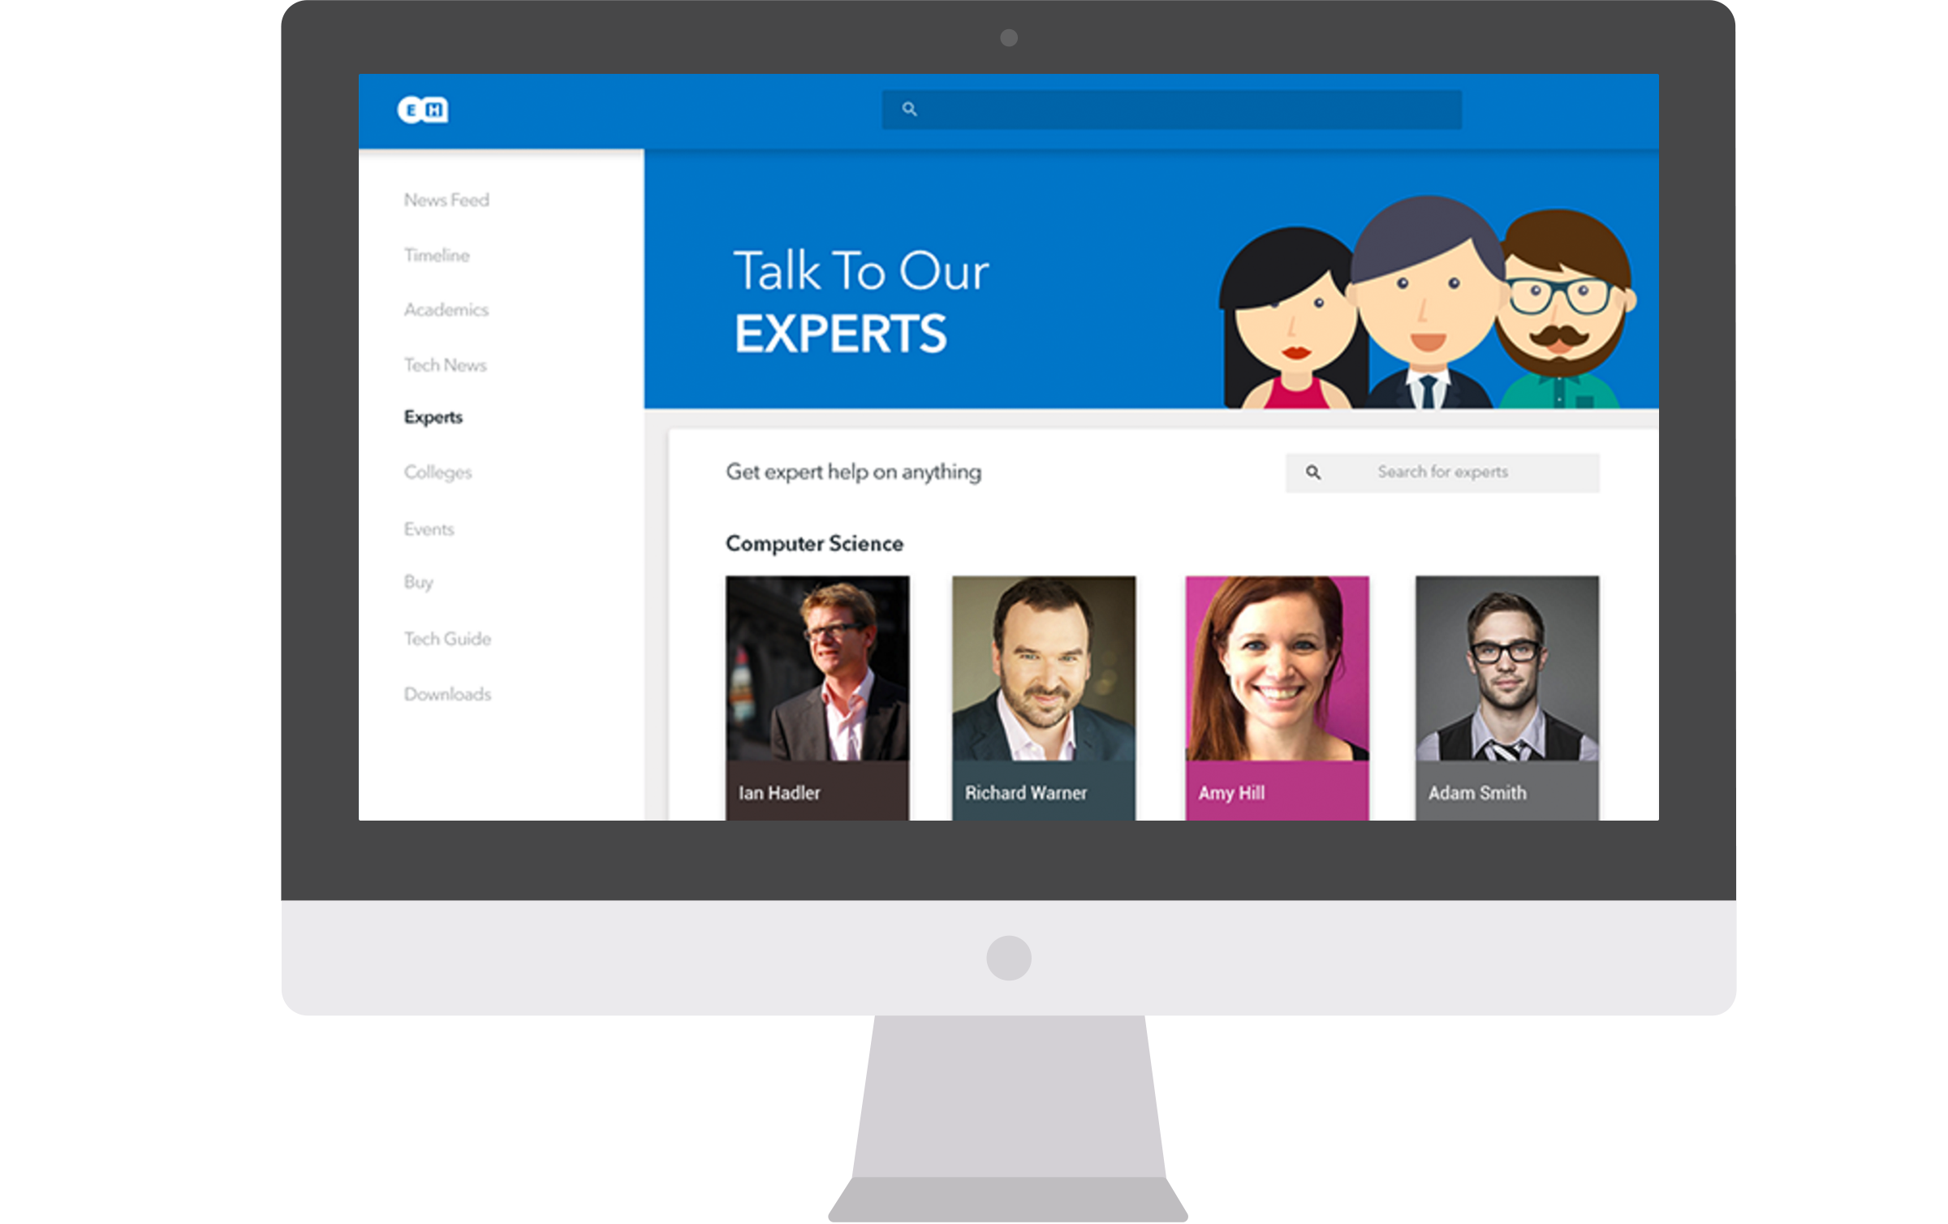

Slide 29
Animation
Animations (motion, interaction & transitions) are an engaging part of Material Design.
Each interaction is thoughtful, perhaps whimsical, but never distracting
Motion helps UI elements appear tangible
Motion should be meaningful and direct user attention

Slide 30
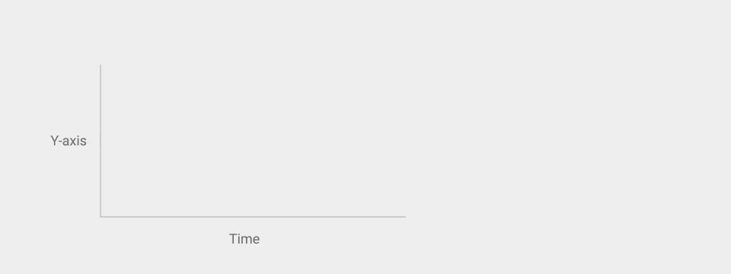
Animation
Acceleration and deceleration is natural
During transitions, consider what part of the entrance or exit must receive the most attention

Slide 31

Animation
Best practice: Use overlapping motion to direct user attention

Slide 32
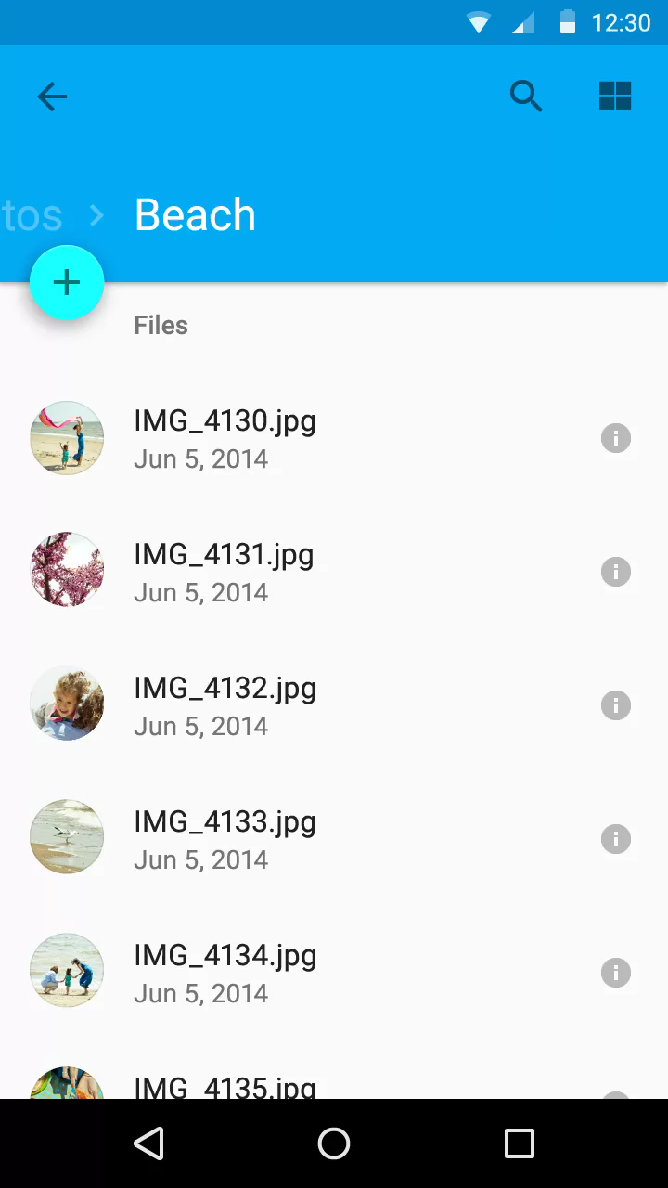
Animation
Best practice: Incoming elements may expand into view, but content should only fade in

Slide 33
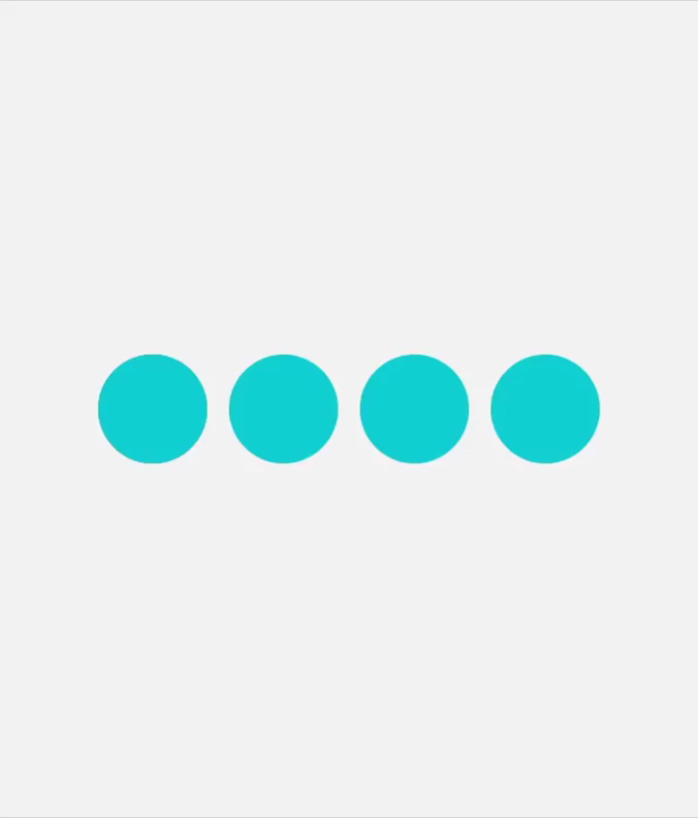
Animation
Best practice: Direct user attention with coordinated, orderly motion

Slide 34
http://www.materialup.com/posts/credit-card-checkout-flow-amex

Slide 35
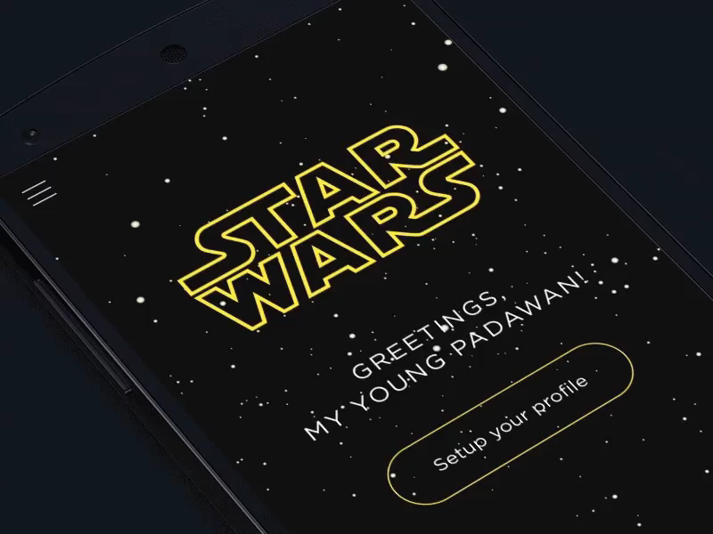

Slide 36
https://www.youtube.com/watch?v=vYrBrbPVtMs

Slide 37
https://www.youtube.com/watch?v=m7pqXqdkeY8

Slide 38
Pros and Cons
Pros
Cons
Consistent look and feel
Can be used across all platforms
Robust
Everything is designed
Material Design feels more natural
Material design controlled by Google
Stringent, lack of creative freedom
Takes longer to implement compared to flat design
There is a learning curve
Can be challenging to make Material Design stick

Slide 39
https://www.youtube.com/watch?v=Xtu7ZOQScrI

